Slide 1
Climate and reservoir management effects on floods
Manuela I. Brunner
GEWEX workshop, 22.09.2023
Contact: manuela.brunner@env.ethz.ch
Notes:
Short introduction on my background and current research project.

Slide 2
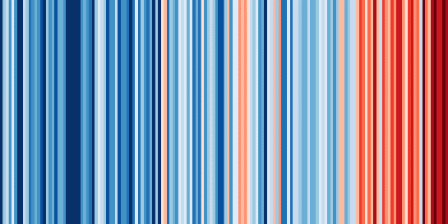
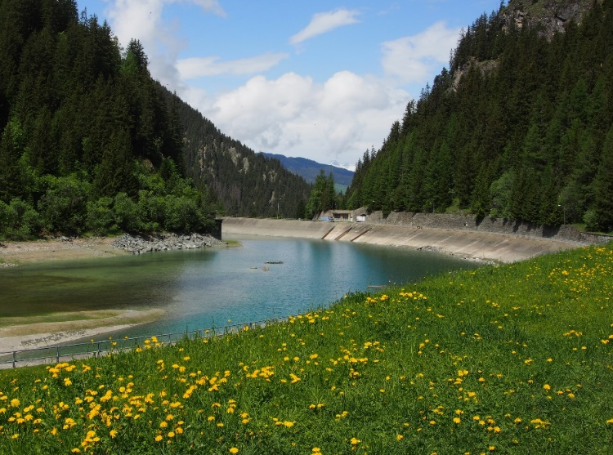
Human influences on floods
Climate
$$Q$$
Floods
$$t$$
Reservoirs
Notes:
Impacts of floods
Impacts of droughts
We as society want to prepare for such events and we want to develop better protection measures.
To do that we need predictions for both types of extremes.
Explain that by prediction I do not mean forecast by rather saying something about the likelihood of occurrence within the next x years.
We need to know how often do such events happen and how big are they going to be.

Slide 3
Climate influences
$$Q$$
Floods
$$t$$

Slide 4
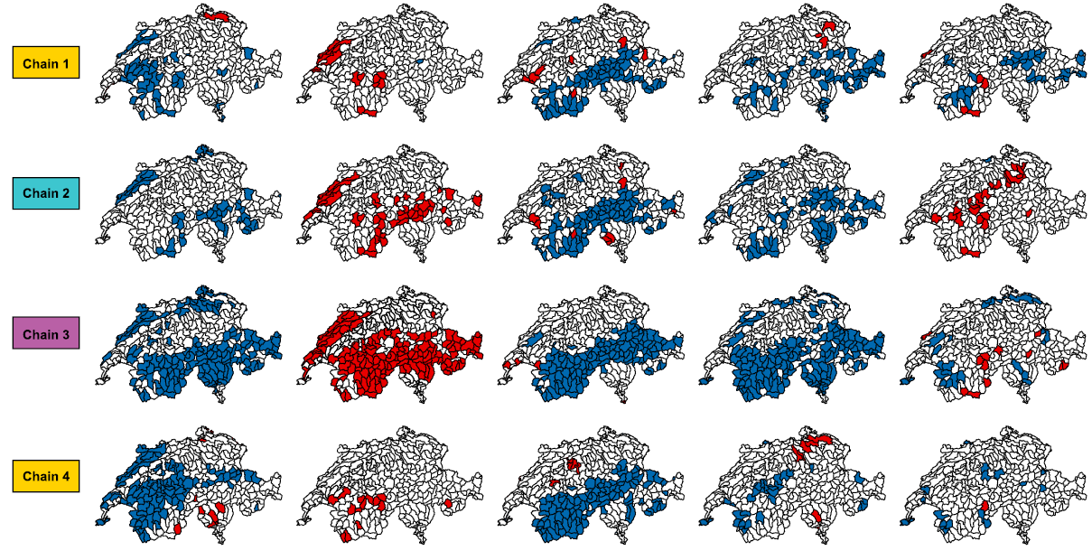
Simulated changes in flood generation processes
Precipitation
Snowmelt
Soil moisture
Peak discharge
Flood volume
Emission scenarios
RCP 2.6
RCP 4.5
RCP 8.5
…
Trends
Non-significant
Negative
Positive
…
Brunner et al. 2019. Water Resources Research

Slide 5
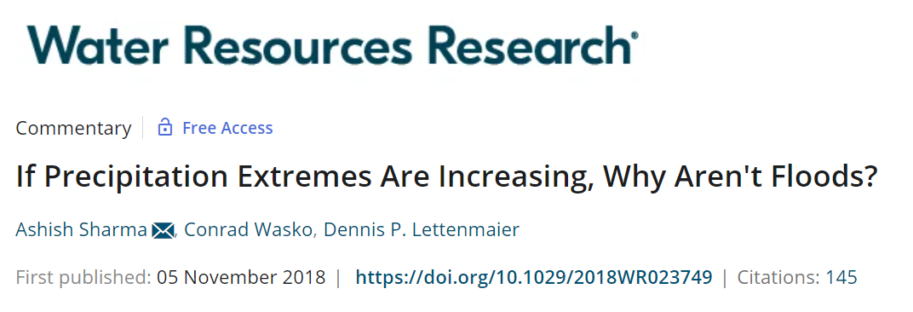
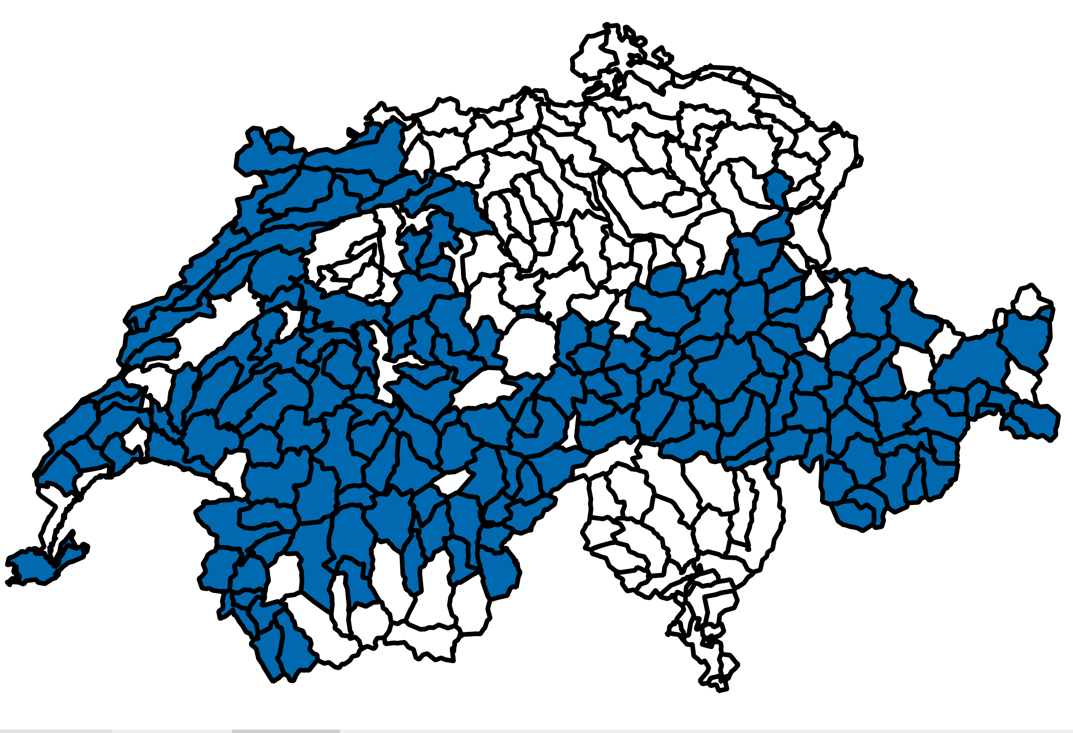
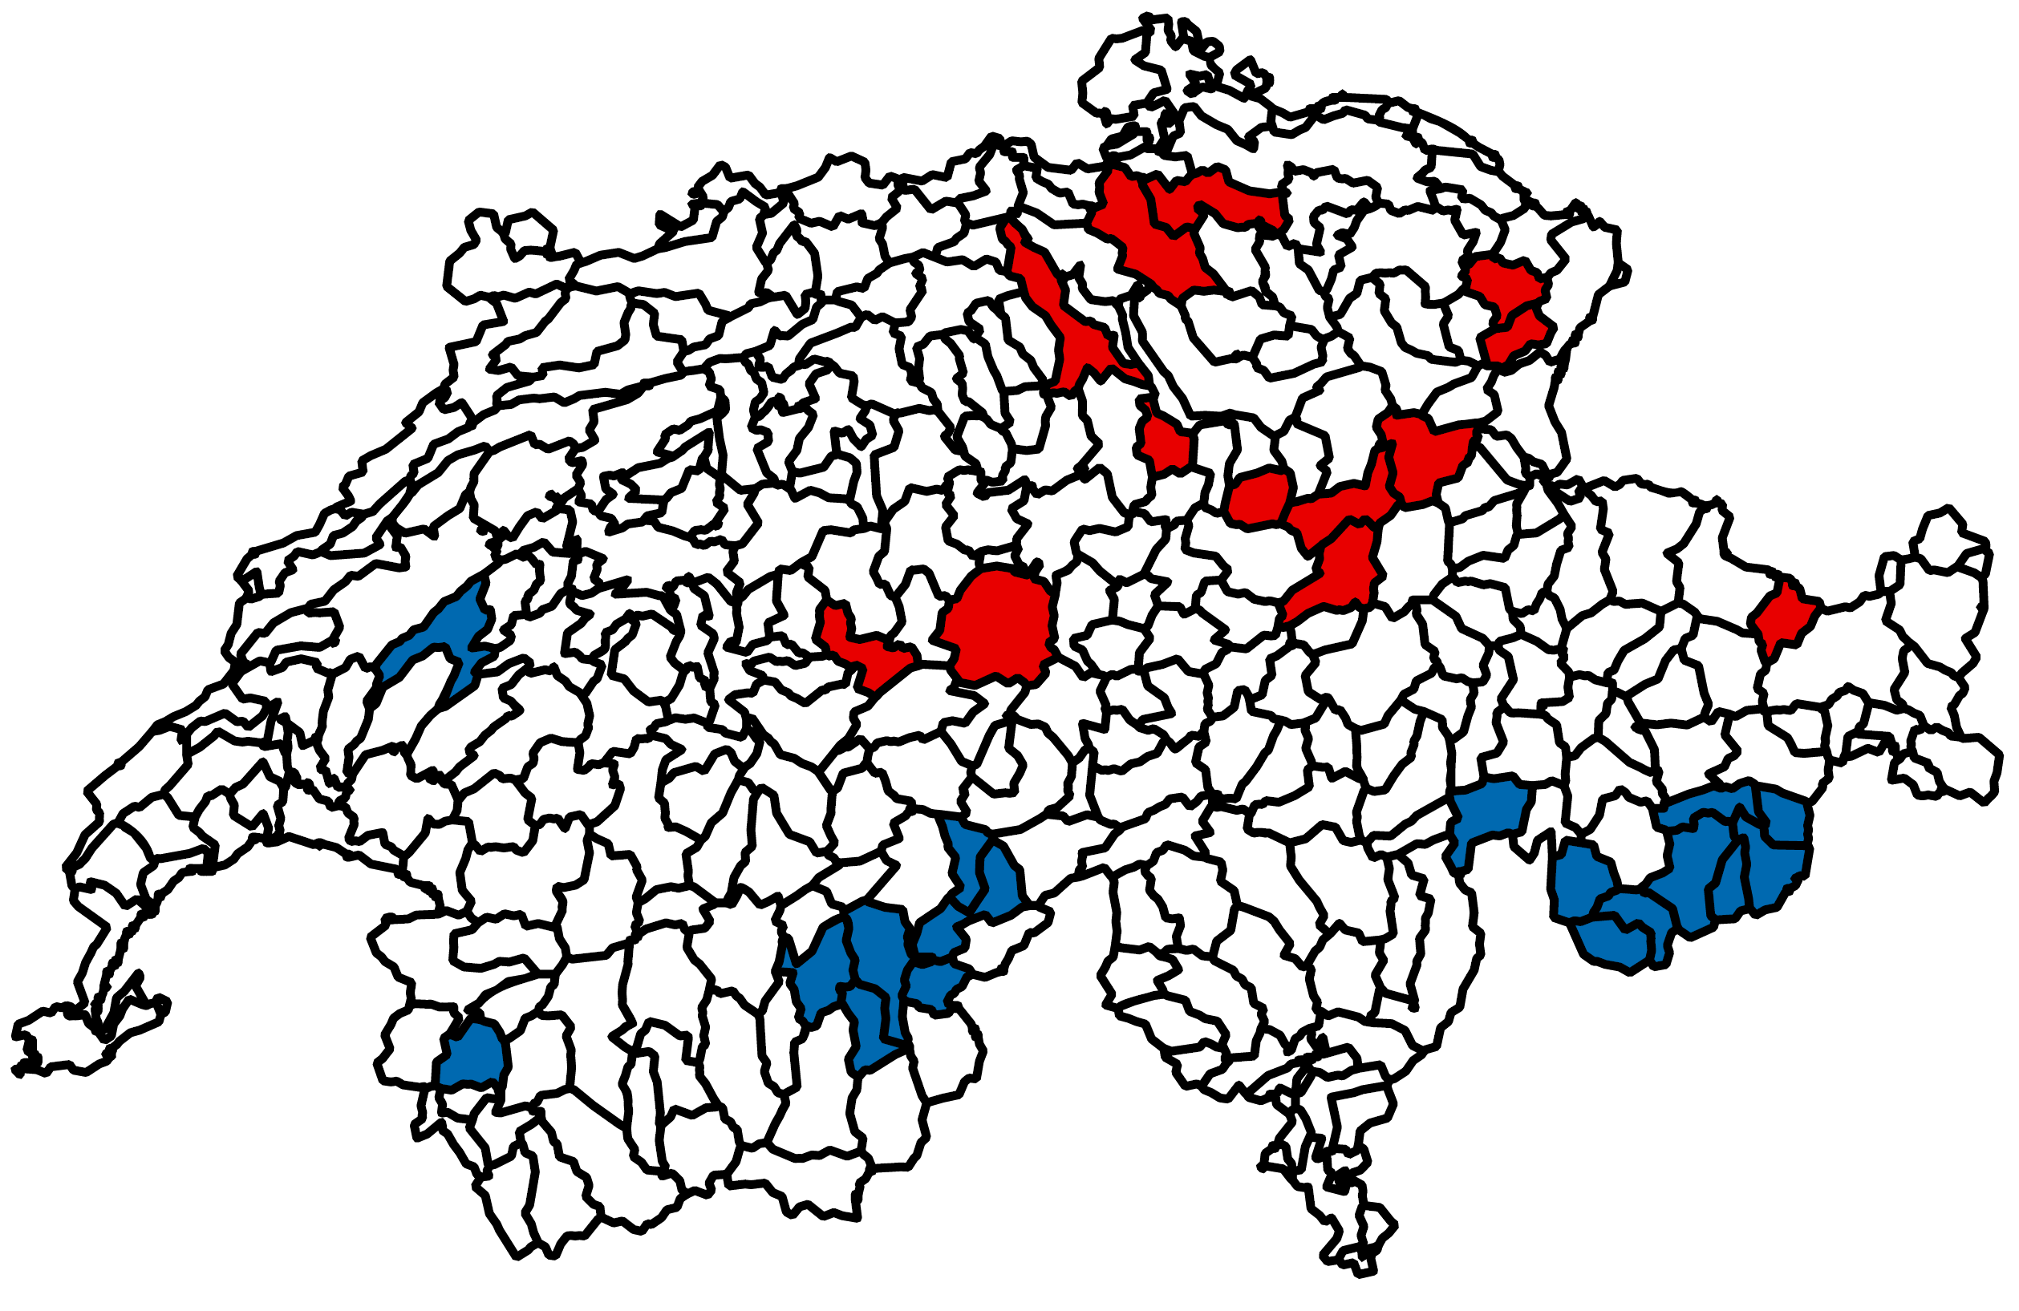
Simulated changes in flood magnitudes
When do increases in extreme precipitation translate to increases in flooding?
Trends
Non-significant
Negative
Positive
Precipitation
Peak discharge
Brunner et al. 2019. Water Resources Research

Slide 6
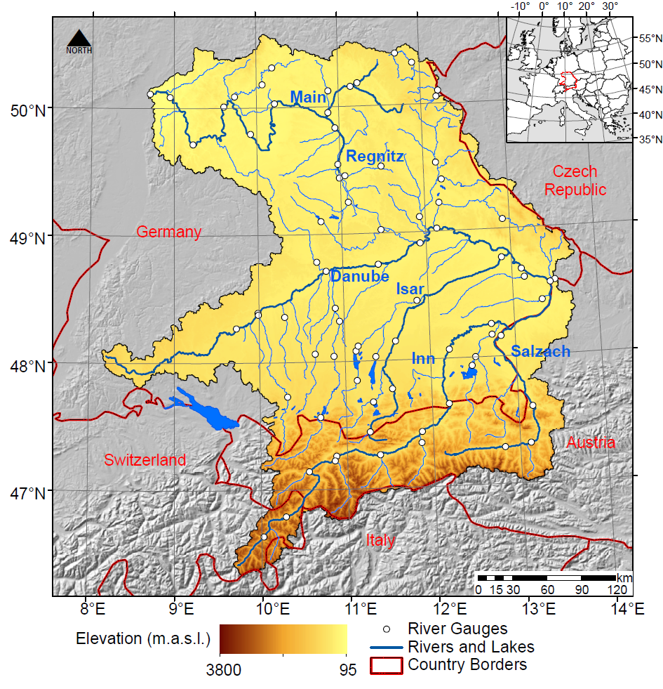
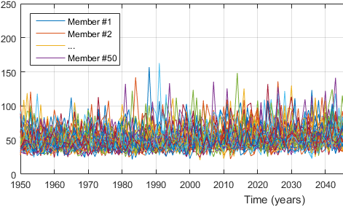
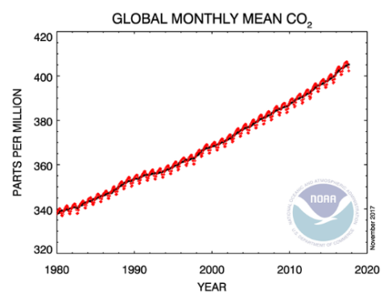
Modeling future changes in floods
Increase sample size to study very rare events
Initial conditions
GCM:
CanESM2-LE
(Kirchmeier-Young 2017)
RCM:
CRCM5-LE*
(Leduc 2019)
Hydrology:
WaSiM*
(Willkofer 2020)
Streamflow
GHG emissions
RCP8.5
50 member x 40 years = 2000 years
Historic + Future streamflow
* Simulations with the CRCM5 and WaSiM were performed within the ClimEx project funded by the Bavarian Ministry for the Environment and Consumer Protection

Slide 7
Extreme value analysis
Identify P-Q pairs
Frequency analysis
Change assessment
Precipitation
P_{T}
F
H
H
Streamflow
Q_{T}
F
H
H
Return period [T]
Historic: 1961-2000
Future: 2060-2099

Slide 8
Future changes in flood frequency
Threshold
Frequency
Discharge
Relative change [-]
Precipitation
Brunner et al. 2021. Communications Earth & Environment

Slide 9
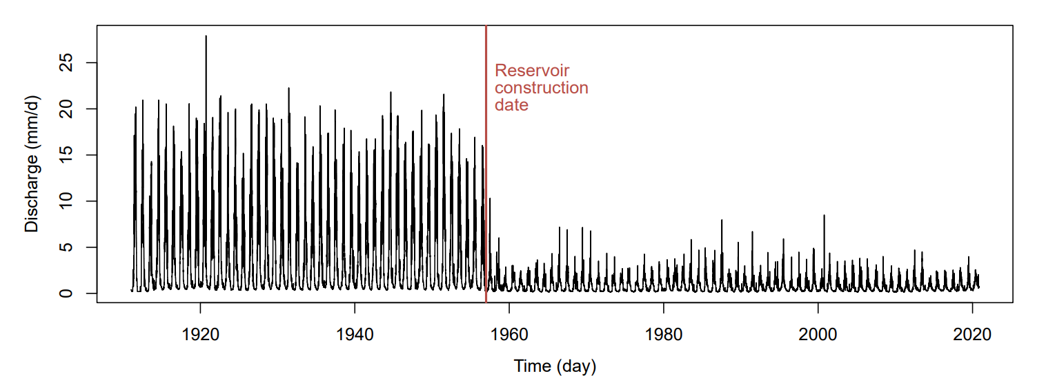
Reservoir influences
Drance de Bagnes: Mauvoisin reservoir

Slide 10
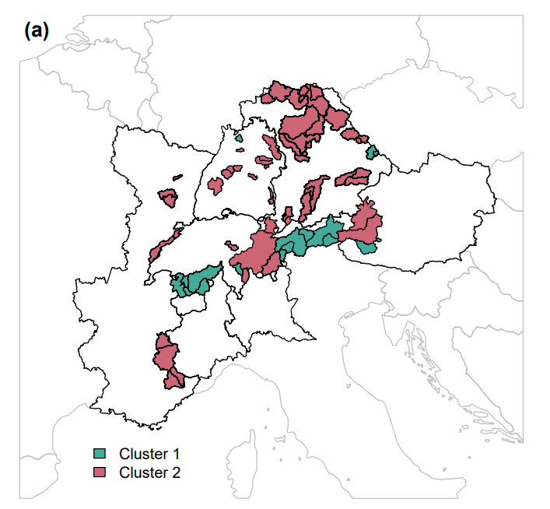
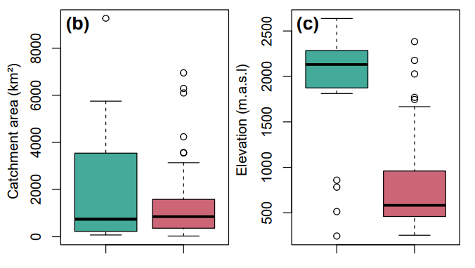
Regulation variations
Strong regulation
Weak regulation
Storage
Strong regulation
Weak regulation
Brunner and Naveau, 2023. Hydrology and Earth System Sciences

Slide 11
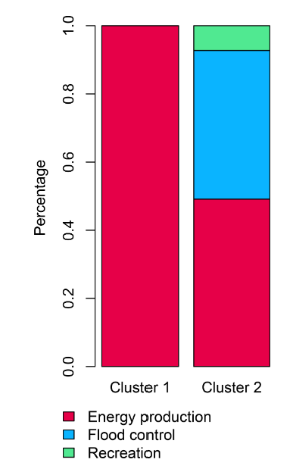
Regulation variations by purpose
Strong regulation
Weak regulation
Strong regulation
Weak regulation
Brunner and Naveau, 2023. Hydrology and Earth System Sciences

Slide 12
Reservoir influences
$$Q$$
Floods
$$t$$

Slide 13
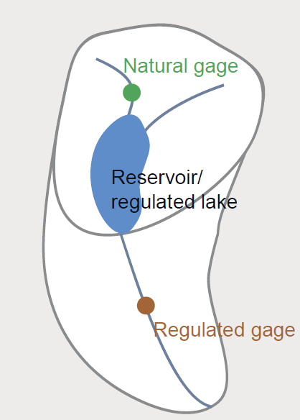
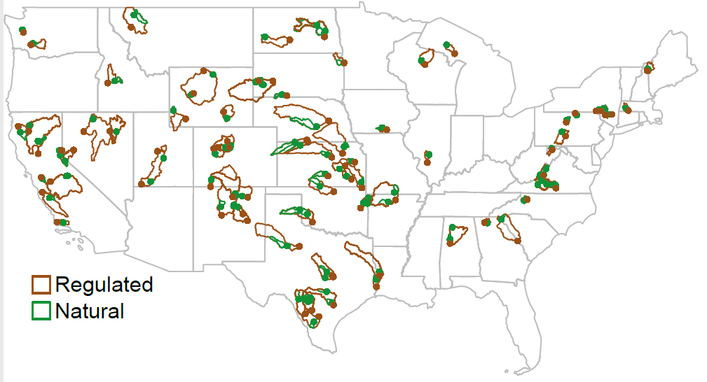
Catchment pairs
Brunner 2021. Environmental Research Letters

Slide 14
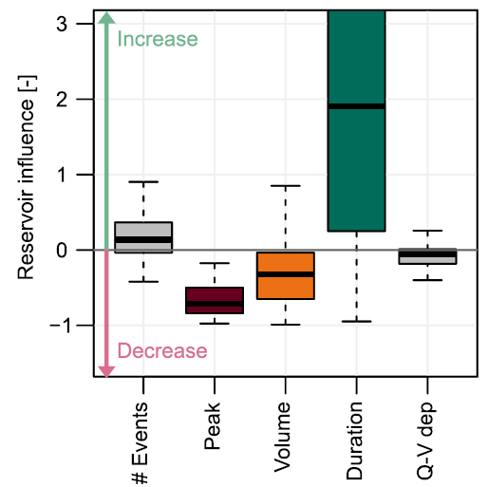
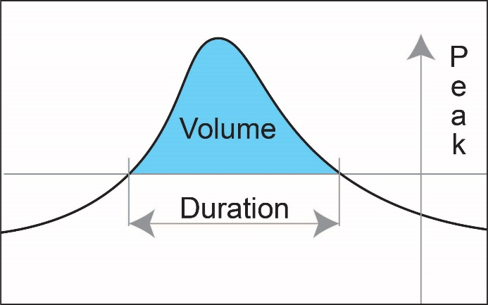
Regulation impacts local flood characteristics
Brunner 2021. Environmental Research Letters

Slide 15
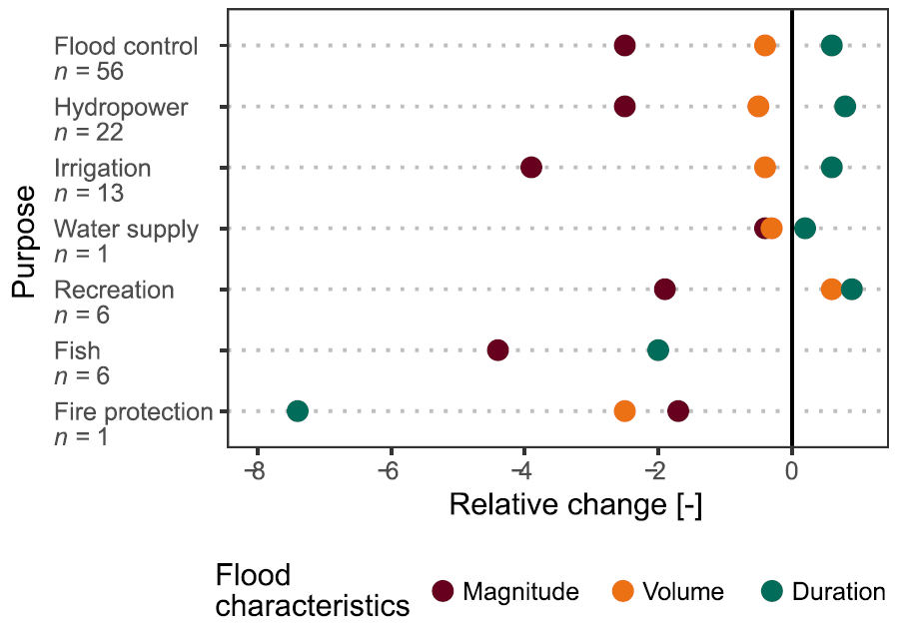
Weak effect of reservoir purpose
Reservoir purposes
Decrease
Increase

Slide 16
Conclusions
Floods are affected by indirect (climate) and direct human influences (reservoir regulation)
$$Q$$
Floods
$$t$$
Further research is needed on the interplay between the two effects
How can we use regulation to alleviate the negative effects of climate change?
Brunner et al. 2019. Water Resources Research: Future trends in the interdependence between flood peaks and volumes
Brunner et al. 2021. Communications Earth & Environment: An extremeness threshold determines the regional response of floods to changes in rainfall extremes.
Brunner 2021. ERL: Reservoir regulation affects droughts and floods at local and regional scales
Brunner & Naveau 2023. HESS. Spatial variability in Alpine reservoir regulation
@ManuelaIBrunner
@HYCLIMM
manuela.brunner@env.ethz.ch

