Slide 1
Two missing physical processes in the climate models for the radiative coupling between cloud and surface in the polar regions
Xianglei Huang¹, Yi-Hsuan Chen^{1*}, Xianwen Jing¹⁺, , Chongxin Fan¹, Xiuhong Chen¹, Ping Yang², Wuyin Lin³
University of Michigan, 2. Texas A&M University, 3. DoE/Brookhaven Lab
* Now at NOAA GFDL/Princeton University ⁺ Now at Hubei Normal University, China
3RD PAN-GASS MEETING
July 25, 2022
Acknowledgements: DoE/BER (DE-SC0019278 and DE-SC0022117)

Slide 2
A few facts:
Atmospheric absorption, scattering, and emission have very strong spectral (frequency) dependence
This is why radiation parameterization is so expensive
As a result, simplifications/approximation must be made to make RT calculation affordable in the earth system models
When radiation schemes were developed decades ago
Polar region was not a key focus
More attention was paid to processes within the atmosphere than to the coupling between the surface and atmosphere
I will discuss two approximations made in the LW radiation scheme: reasonably OK before but not “that” applicable for polar climate simulation

Slide 3
Primer (I): surface spectral emissivity
A function of frequency and view zenith angle
Can deviate from blackbody behavior
35%-40% OLR
Huang et al. (2016)
In current earth system models:
Surface is always assumed to be blackbody in the atmospheric model
In land/ice models, surface can be graybody (no spectral dependence still)

Slide 4
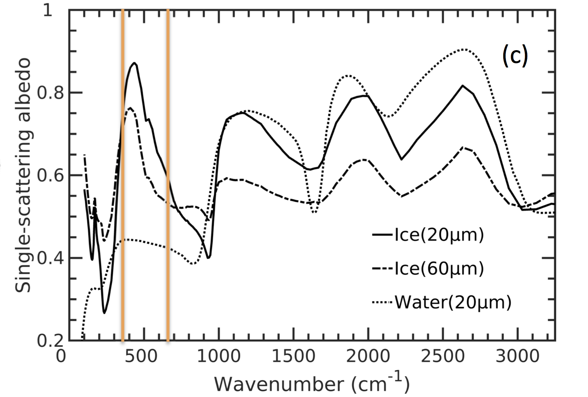
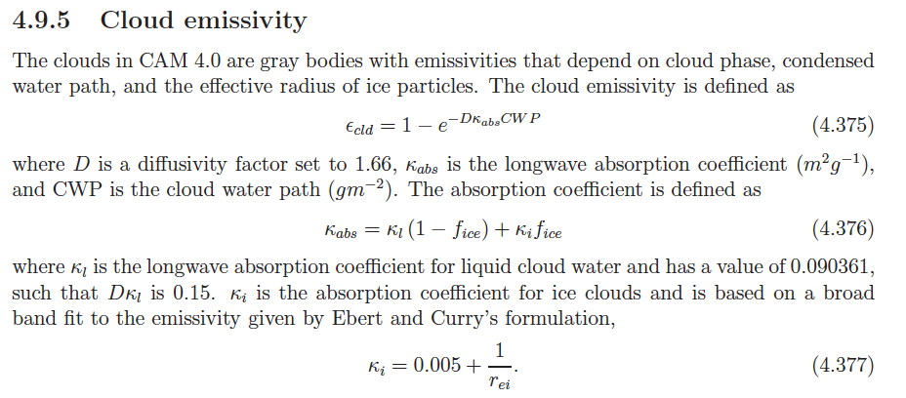
Primer (II): ice cloud longwave scattering
35%-40% OLR
>90% IPCC models assumes cloud being non-scattering in the longwave
NCAR CESM 1.1.1 Technical Description
(Based on Kuo et al., 2017)

Slide 5
What’s the traditional wisdom for these two approximations, blackbody surface and non-scattering clouds in the LW?
What could go wrong with such approximations?

Slide 6
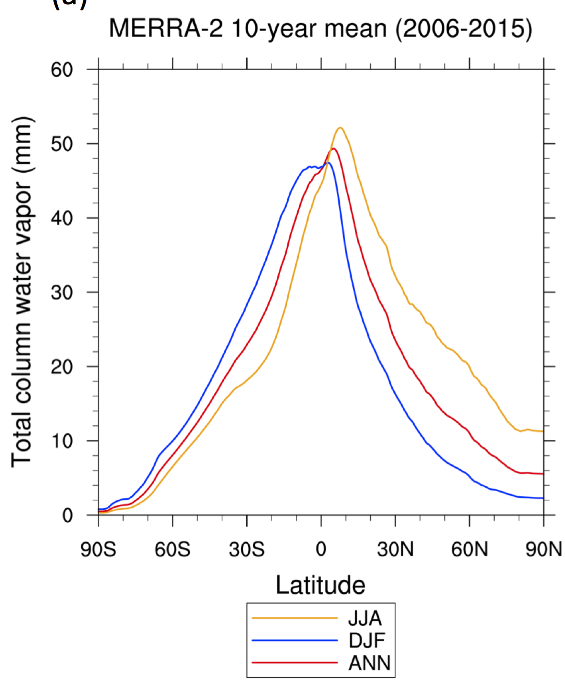
When radiation scheme was developed decades ago …
Polar region is not a focus.
Water vapor abundance changes a lot from the tropics to polar regions

Slide 7
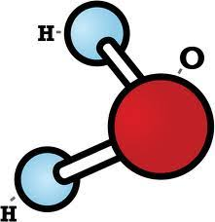
The aftermath of small TCWV in polar regions and beyond (I)
Tropics & mid-latitudes (mid-troposphere & below)
Far IR: Strong H₂O absorption
Two RRTMG far-IR bands

Slide 8
The aftermath of small TCWV in polar regions (II)
At surface
35%-40% OLR
Flux (W m⁻² per cm⁻¹)
SAS: subarctic summer (60ºN)
Dirty window

Slide 9
Real World
GCM “World”
emission/absorption
?
non-scattering cloud
scattering
Atmos-surface coupling manifests the scattering effect
?
surface emissivity
Blackbody surface
blackbody surface

Slide 10
On top of above considerations: seasonality matters
SW
LW
LH
SH
Global Average
surface
LW
Arctic winter
LH
SH
surface
Sea Ice
Hypothesis: missing LW processes would affect Arctic winter T_{s} the most, which then affects subsequent processes and feedbacks in the following seasons.

Slide 11
Treat the two missing processes (Huang et al. 2018; Chen et al. 2020)
Ice cloud | MC6 ice cloud optics A hybrid 2S/4S LW scattering solver into RRTMG_LW (Toon et al., 1989; Kuo et al., 2020)
Surface spectral emissivity | Based on the spectral emissivity database (Huang et al., 2016) Prescribed land spectral emissivity Prognostic spectral emissivity over sea ice and ocean
Implementation | CESM1; E3SM v1; E3SM v2

Slide 12
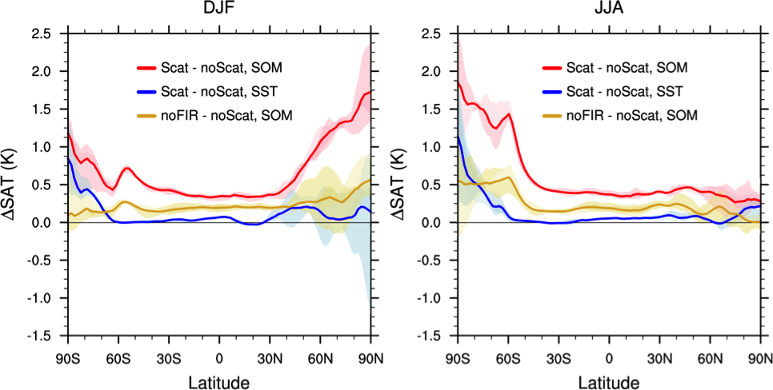
Impact of including ice-cloud scattering alone
Cloud LW scattering effect
SOM >> prescribed-SST
polar >> tropics/mid-latitudes
polar winter > polar summer
far-IR >> other band for the impact
SOM: slab-ocean model
SST: prescribed SST run (AMIP run)
(Chen et al., 2020)
Notes:
Now we look at the scattering effect in boreal summer, Jan-Jul-August.
In the tropics/mid-lat, the scattering effect in DJF and JJA are similar, because the seasonal variation in water vapor amount is small. In the Arctic, you can see the scattering effect become much smaller and the SOM and SST runs are not well separated. This is because in the Arctic summer, the water vapor amount becomes larger than winter, reducing the scattering effect. Also, in summer, solar radiation can affect SAT. In the Antarctic, the scattering effect in wintertime is larger the summertime counterpart.
There is much info in this figure so I give a quick summary.

Slide 13
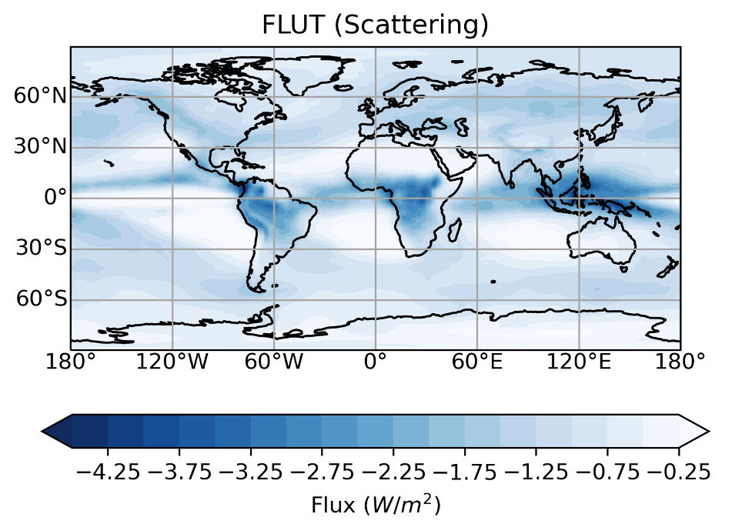
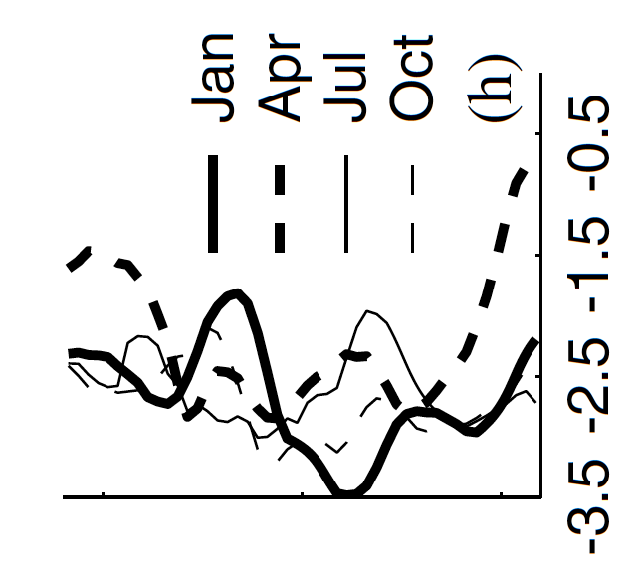
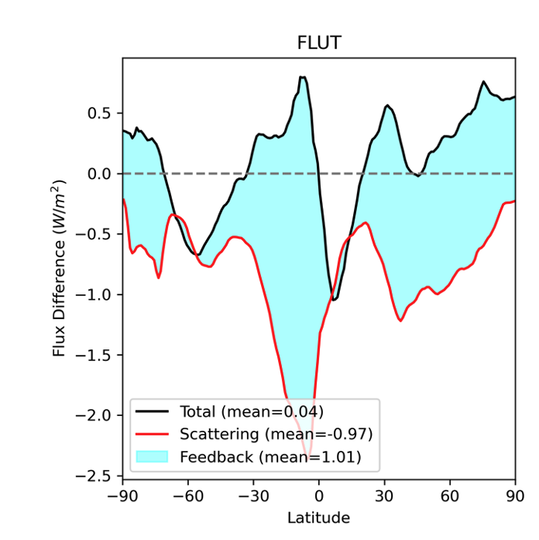
Ice-cloud scattering impact: the polar amplification
OLR difference caused by ice-cloud LW scattering only (offline calculation)
60
0
-60
Costa & Shine, 2006 (ERA40 + ISCCP)
E3SM v2 results

Slide 14
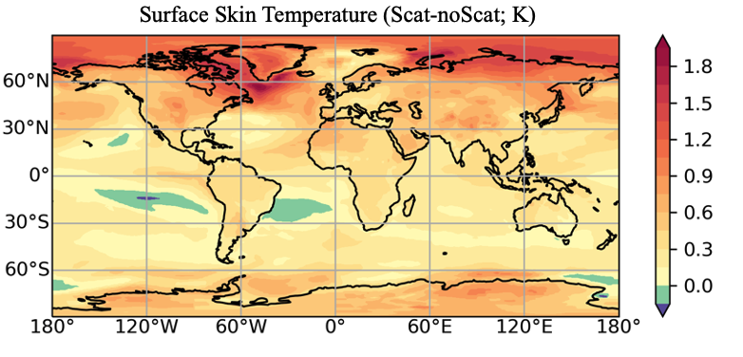
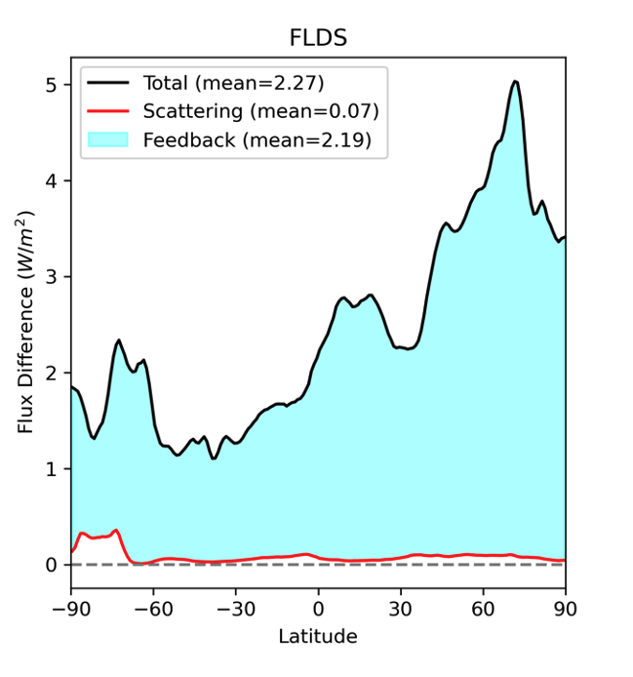
Ice-cloud scattering impact: spatial pattern
E3SM v2 fully coupled run 30-year mean difference

Slide 15
Impact of including surface spectral emissivity alone
Slab-ocean run
Fully-coupled run
(Huang et al. 2018)

Slide 16
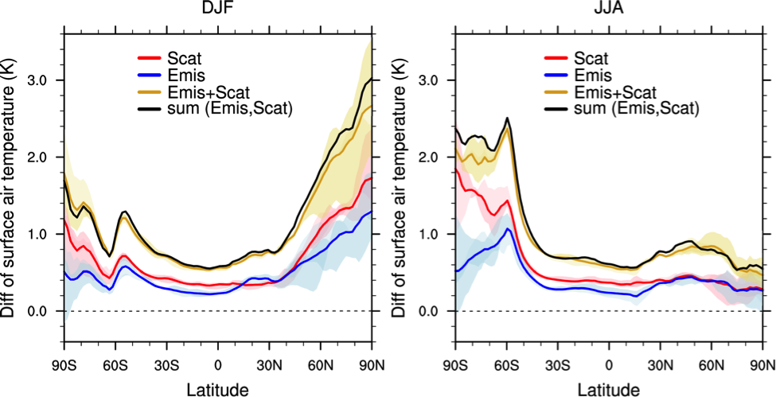
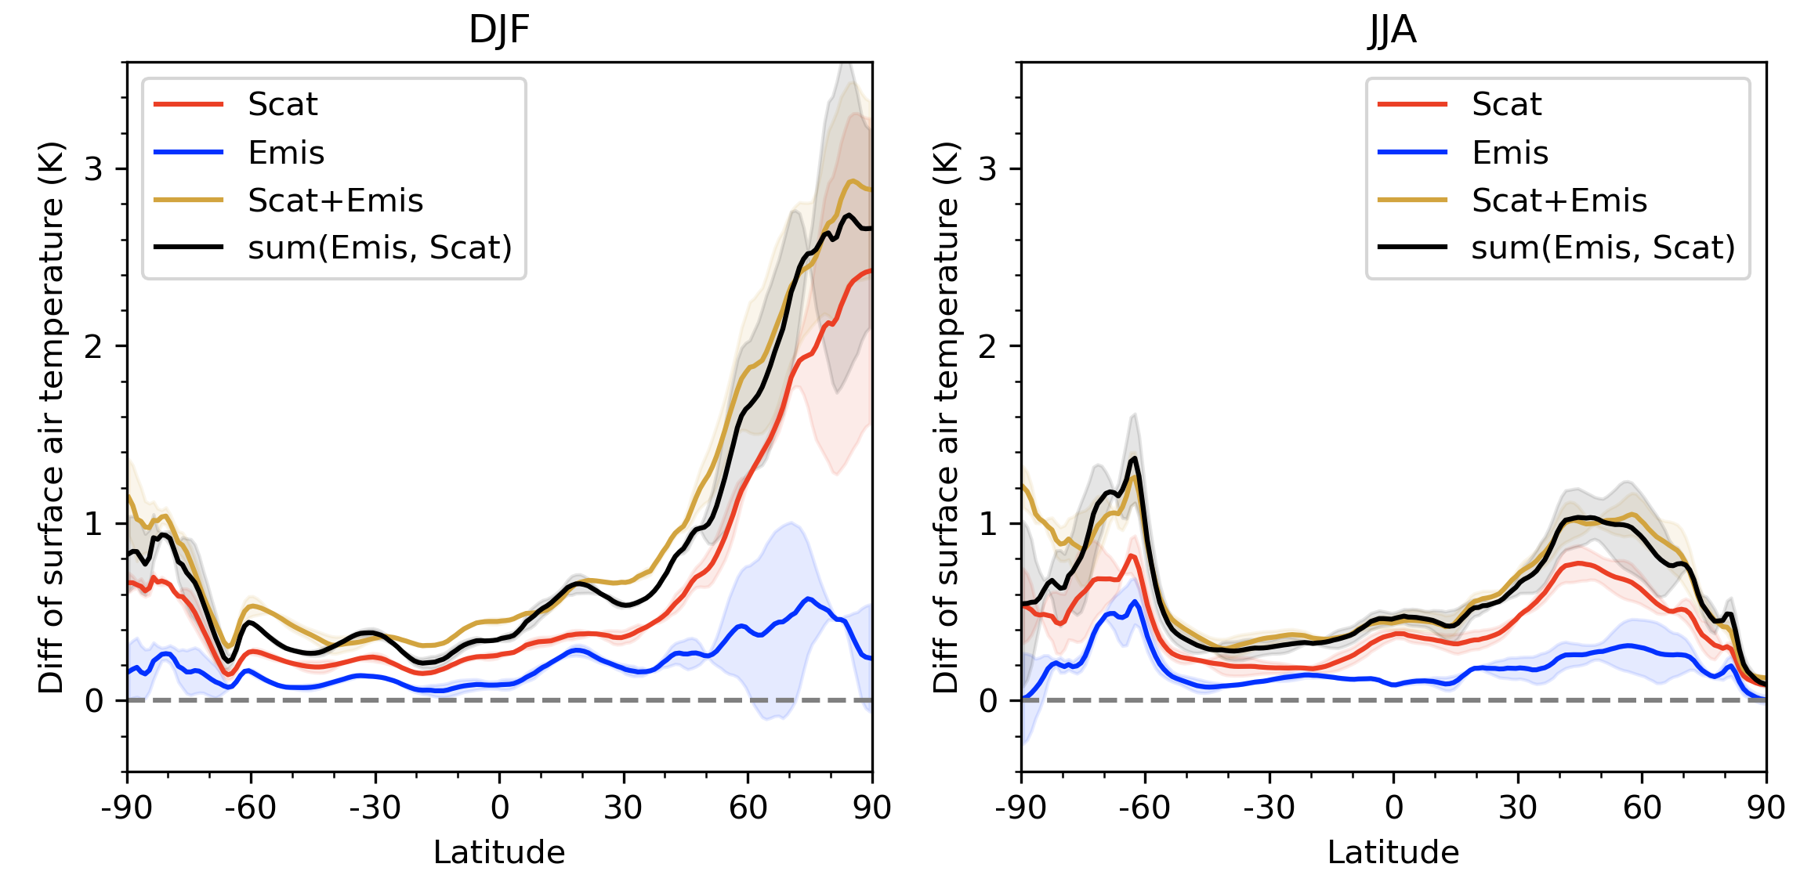
When both processes are included …
(manuscript in preparation)
DoE E3SM v2: fully-coupled run
NCAR CESM 1: slab-ocean run
(Chen et al., 2019)
30-year climatology

Slide 17
Understand the simulations
Compared to the standard climate models
Both far-IR and window band emissivity can be < 1
Include ice-cloud scattering
Reduced upward LW flux @sfc
Reduced OLR and increased atmospheric LW absorption (“like GHG”)
SurfaceT_{sfc} goes up
Feedbacks to ΔT_{sfc}

Slide 18
Conclusions and discussions
LW scattering and surface spectral emissivity: two missing LW physics in current climate models.
Together, they matters the most for polar surface energy budget.
If we want to improve the fidelity of the polar simulations, we need to include such processes.
For the mean state, both mechanisms help increase the surface temperature (w.r.t. current treatments)
What have been used to compensate the effect of such missing physics in the models?
Far-IR matters the most here, but observations are virtually non-existing
Two missions in this decade, PREFIRE (NASA) and FORUM (ESA) will fill in this uncharted observational “territory”

Slide 19
References
Thank You!
Chen, X. H., X. L. Huang, M. G. Flanner, Sensitivity of modeled far-IR radiation budgets in polar continents to treatments of snow surface and ice cloud radiative properties, Geophysical Research Letters, doi:10.1002/2014GL061216, 41(18), 6530-6537, 2014.
Huang, X. L., X.H. Chen, D. K. Zhou, X. Liu, An observationally based global band-by-band surface emissivity dataset for climate and weather simulations, Journal of the Atmospheric Sciences, 73, 3541-3555, doi:10.1175/JAS-D-15-0355.1, 2016.
Huang, X. L., X. H. Chen, M. G. Flanner, P. Yang, D. Feldman, C. Kuo, Improved representation of surface spectral emissivity in a global climate model and its impact on simulated climate, J. Climate, 31(9), 3711-3727, doi:10.1175/JCLI-D-17-0125, 2018.
Chen, Y.-H. Influences of Surface Spectral Emissivity and Cloud Longwave Scattering on Climate Simulations, Ph.D. Dissertation, Univ. Michigan, 2019.
Chen, Y.-H., X. L. Huang, P. Yang, C.-P. Kuo, X. H. Chen, Seasonal Dependent Impact of Ice-Cloud Longwave Scattering on the Polar Climate, Geophysical Research Letters, 47(23), e2020GL090534, https://doi.org/10.1029/2020GL090534, 2020.

