Slide 1
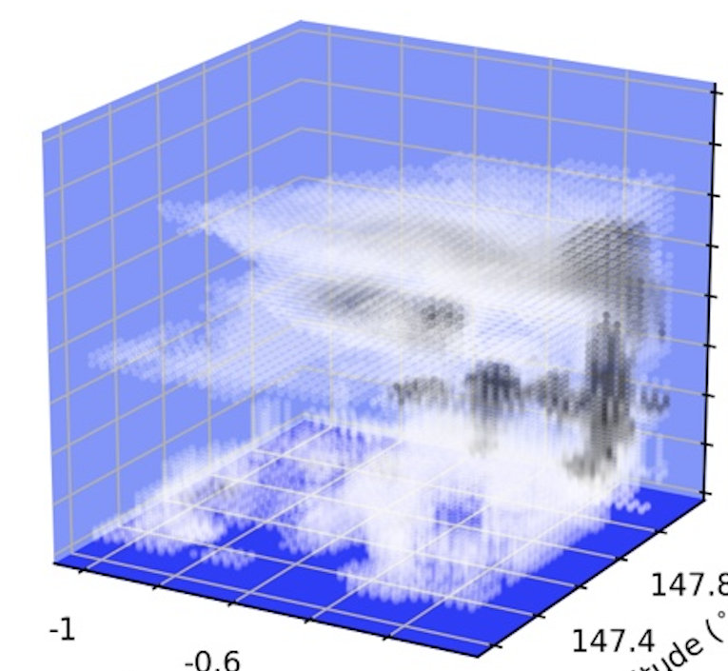
An intercomparison of tropical cirrus in DYAMOND models
Sami Turbeville*, Jacqueline Nugent, Tom Ackerman, Peter Blossey, and Chris Bretherton
University of Washington
UMAP Pan-GASS 2022
Notes:
First I’d like to thank my co-authors – Jacqueline has a poster
Thank you to DKRZ for hosting the DYAMOND data
… NSF PIRE for funding
Thank you for your attention during the last talk of the day! If you saw my poster at CFMIP, this talk will be very similar
Alright, I’ll get started. Today I’ll be showing you some preliminary results from my intercomparison of tropical cirrus in the dyamond models. I am also going to be adding in observations to ground the models in reality so this is also an EVALUATION

Slide 2
An intercomparison of tropical cirrus in DYAMOND models
& evaluation
^
Sami Turbeville*, Jacqueline Nugent, Tom Ackerman, Peter Blossey, and Chris Bretherton
University of Washington
UMAP Pan-GASS 2022
Notes:
of dyamond models. Even though my true interest is in cirrus clouds but I don’t have time to go into too many details here so I’ll talk more generally about

Slide 3
An intercomparison of tropical cirrus in DYAMOND models
& evaluation
^
high clouds
Sami Turbeville*, Jacqueline Nugent, Tom Ackerman, Peter Blossey, and Chris Bretherton
University of Washington
UMAP Pan-GASS 2022
Notes:
HIGH CLOUDS in the dyamond models for this talk.
As some motivation: I’m showing a plot here of an anvil cloud system from one of the DYAMOND 1 models. I’m plotting cloud mass for each grid cell and vertical level so you can see the amount of detail and complexity in just this tiny subset – the horizontal scale here is 1 deg (one grid point in a coarse GCM) and the anvil reaches up to ~15 km. You can see the convective core in the corner with a very nice anvil spreading out across the box. We even see two layers of anvil and some underlying low clouds. So very complex and detail even in this one snapshot. So I’ll try to tell you a story about these complex clouds in the DYAMOND models.

Slide 4
DYAMOND DYnamics of the Atmospheric general circulation Modeled on Non-hydrostatic Domains
Image courtesy of ESiWACE
10 Global Storm-Resolving Models (GSRMs)
Phase 1 – boreal summer
Phase 2 – boreal winter
High spatiotemporal resolution
2.5-5km horizontal resolution
51-131 vertical levels
15 min 2D & 3hrly 3D output
40-day simulation
Explicit convection
Free running (not nudged)
(Stevens et al., 2019 PEPS)
Notes:
DYAMOND has been mentioned quite a few times already. But here is a reminder – I’m working with a handful of models from DYAMOND 2 – the winter simulation. These are 40-day simulaitons with explicit (non-parameterized) convection and they are free running (not nudged to meteorology)
The GOAL of this talk is to convince you that global storm-resolving models like those from DYAMOND are simulating clouds and convection in a way that is interesting and maybe even realistic!
but I’m also going to give you a list of caveats going a long with that stemming from some fairly large model biases

Slide 5
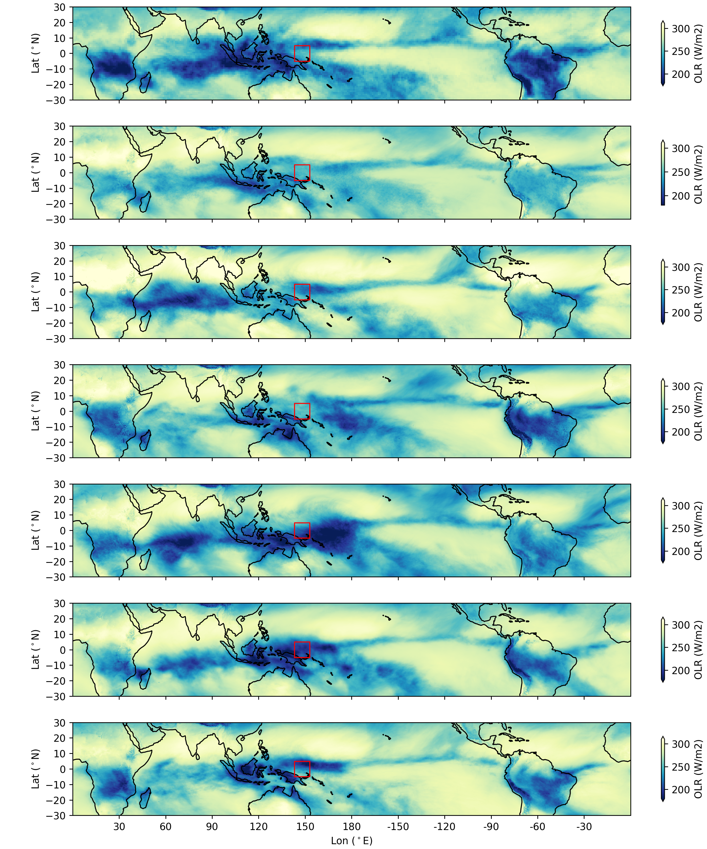
Models simulate the spatial pattern of OLR reasonably well compared to observations
CERES SYN1 deg
ICON
Latitude
300
SCREAM
NICAM
280
Latitude
260
OLR (W/m2)
SAM
UM
240
Latitude
220
ARPEGE
GEOS
200
180
Latitude
Longitude
Longitude
Main differences are land-ocean contrasts
Notes:
Here I am showing the tropical band from 30N to 30S plotting the time mean of outgoing longwave radiation. Obs on top left panel - CERES syn 1 deg mean for the same month as the DYAMOND models (Jan-Feb 2020). The rest are a handful of the dyamond models – there were 10 models but I’m only showing 6 here and for the rest of the talk.
So, this gives you an idea that the models are making appropriately deep clouds in about the right places. For the rest of the talk, I’m going to zoom in on one focus region, the tropical west pacific.

Slide 6
How well do DYAMOND models simulate clouds in the Tropical Western Pacific (TWP) region?
CERES Observations
Notes:
Our main question is how well do they simulate clouds specifically tropical convection? We are looking at the TWP as an example region – the red box here is 10 x 10 deg. We chose the TWP because among other reasons it has a neutral net cloud radiative effect – so there is a balance between LW and SW at TOA.

Slide 7
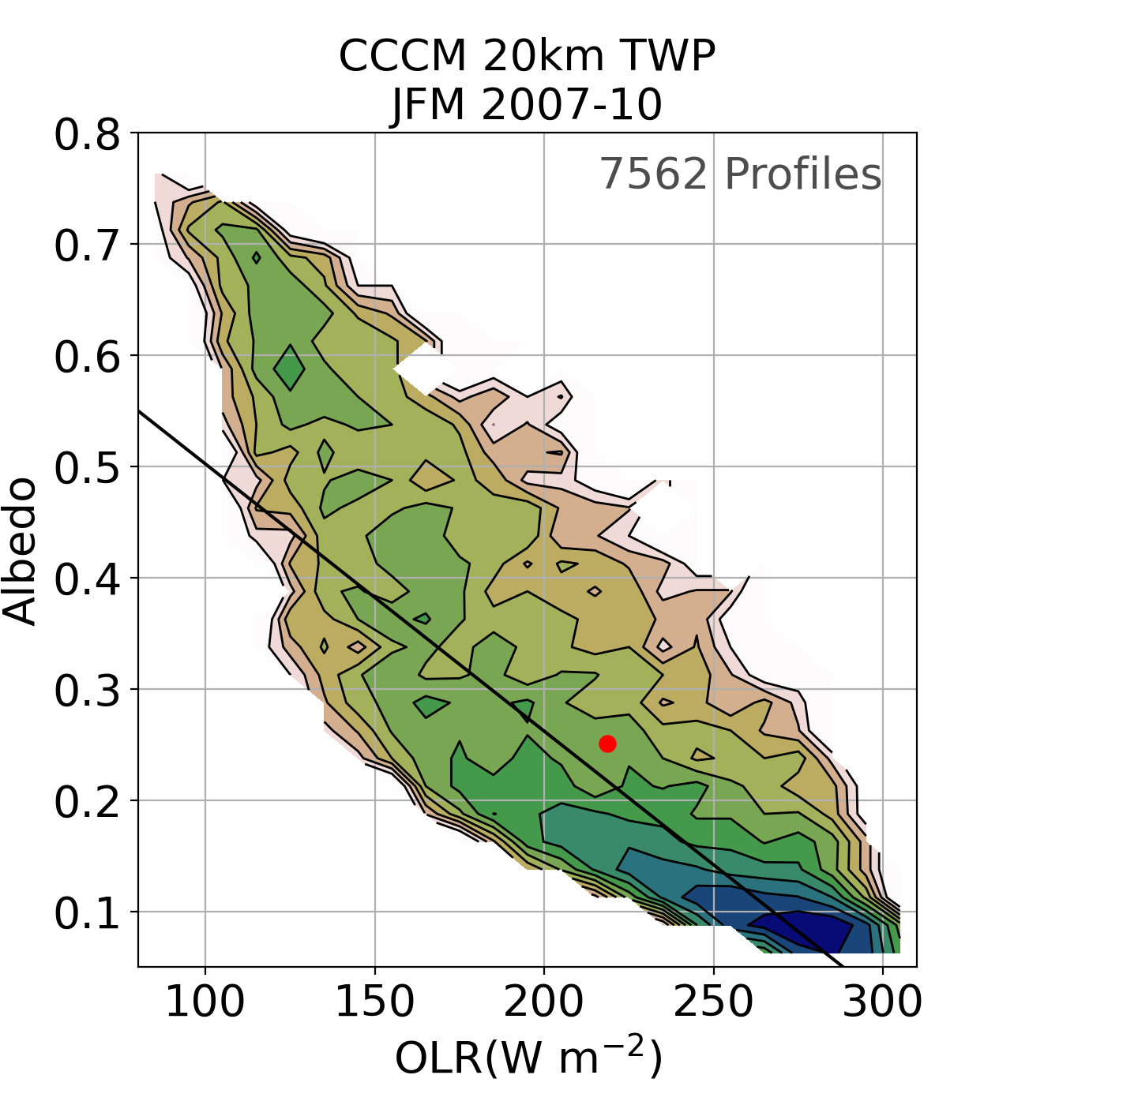
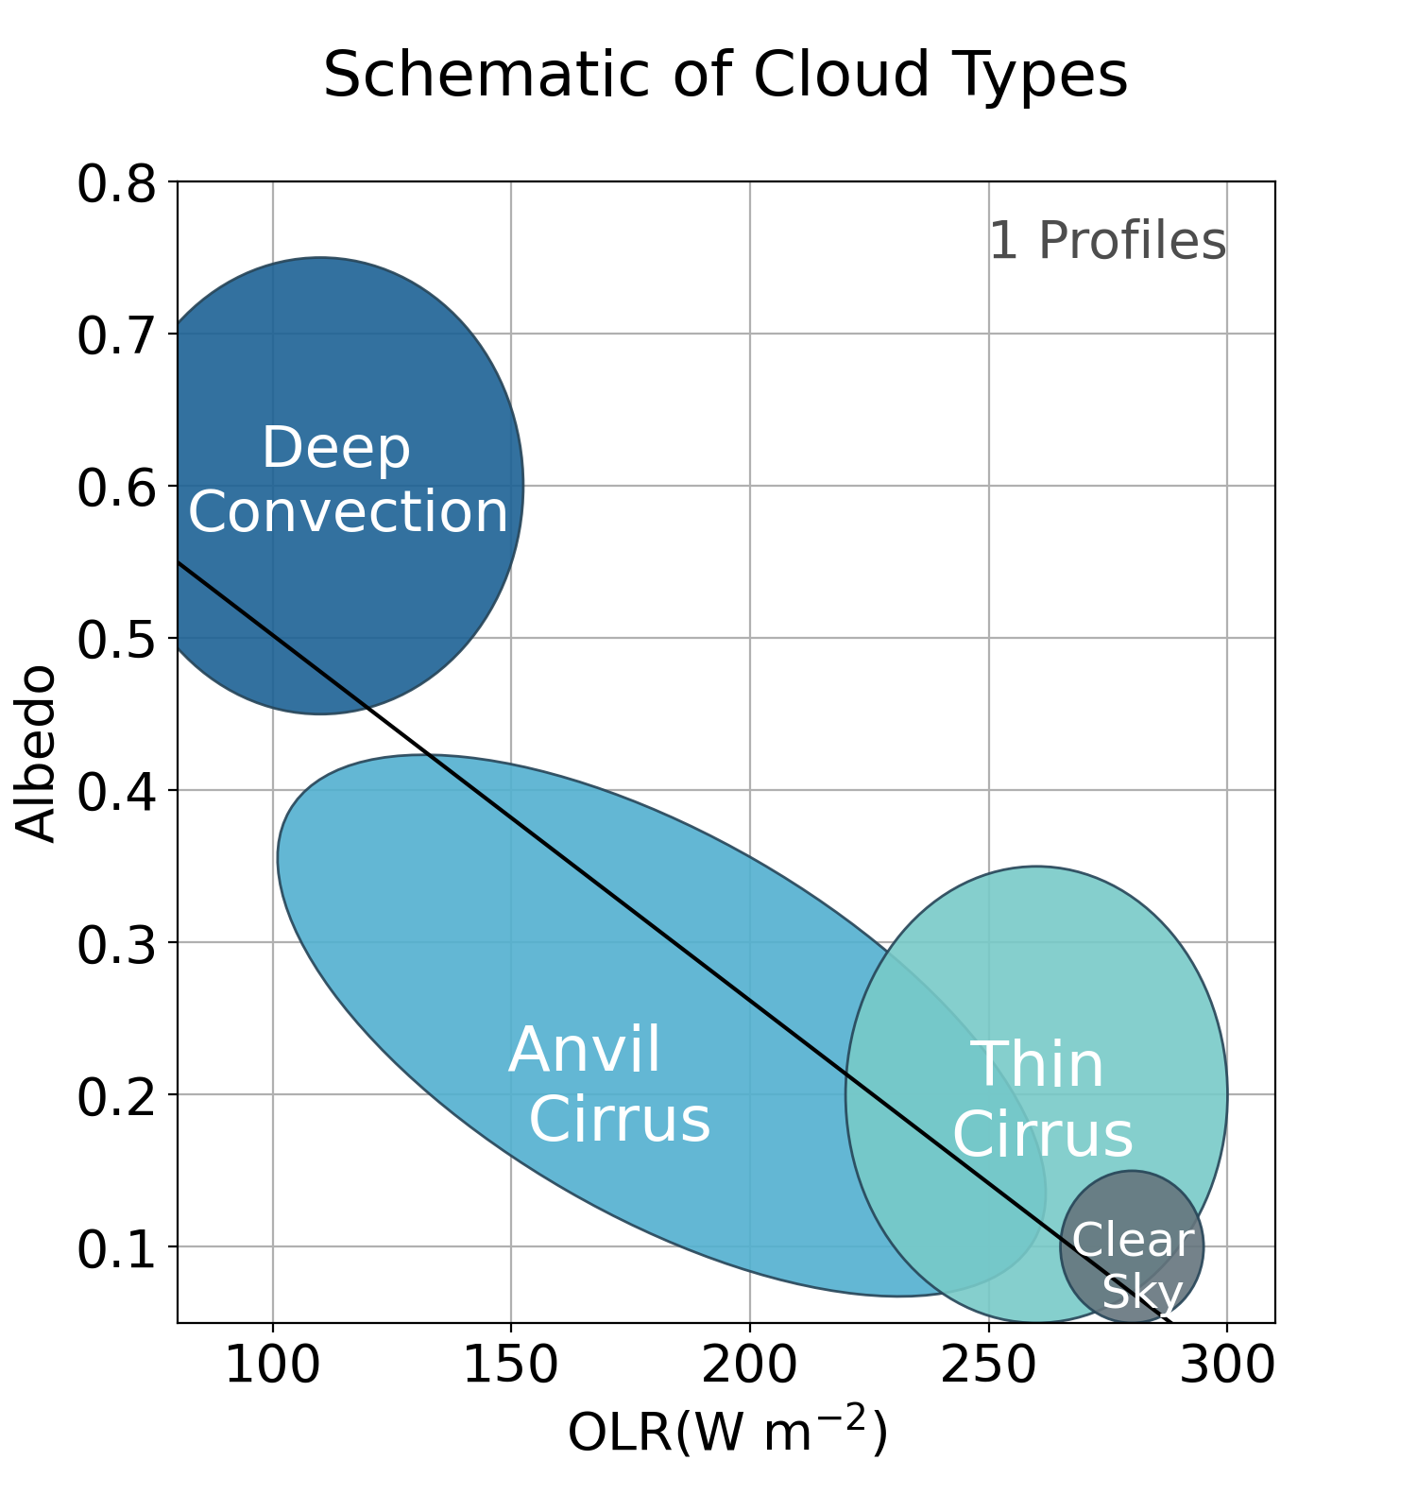
Observations have a banana-shaped distribution of clouds from deep convection to thin cirrus
Clear sky values are included, Black line is where CRE = 0
Notes:
axis description – OLR on the x from 80-310 W/m2; albedo on the y.
Most columns are clear sky or near it (dark blue in the lower right).
Thin cirrus have a small difference from clear sky – I’ve made a simple schematic on the right to show the three main cloud types you might expect to find for each OLR-albedo pairing.
At intermediate values of albedo OLR we have thicker clouds like those from anvil outflow. and remember that the clouds are very complex and detailed here so these categories of clouds are just rough estimates to help orient you.
finally we see deep convection in the upper left corner at high alb low OLR. The observations show a secondary peak in the joint histogram here.

Slide 8
NICAM qualitatively captures the key aspects of the observations
Congestus
Deep convection
Anvil cirrus
Thin cirrus
Black line is where CRE ≅ 0 from obs, models coarsened to match obs
Notes:
So we will first look at one model – NICAM.
Captures the banana-shaped distributions for the most frequent clouds (green shades)
Deep convection maybe slightly underestimated in NICAM but reaching appropriate values of OLR and albedo.
NICAM’s anvil cirrus are shifted to slightly lower albedo-OLR values – thinner but higher
Thin cirrus seem pretty good!
But we do see clouds happening at albedo-OLR pairings not present in observations at High albedo, High OLR – we claim these are congestus clouds – I’ll talk a bit more about these later too
Now let’s see what the other DYAMOND models are doing.

Slide 9
There is large model spread in the shape of distributions and frequency of cloud types
“Popcorn” convection
Too many congestus
Notes:
Right off the bat, you can see a wide spread in the models in shape and frequency. I’ll draw your attention to a couple of interesting points.
1. Disconnected deep convection = “popcorn” convection
2. Congestus - These seem to be clouds that are reaching up to or just past the freezing level. While this isn’t seen in observations – they are known to happen at small scales (so maybe models are just overdoing it). This is interesting because we did not see this behavior in any of the DYAMOND 1 models except for FV3.
As you can see the joint histogram is an interesting metric to compare the models. Now I’ll show you a bit of the vertical structure of clouds in each model.

Slide 10
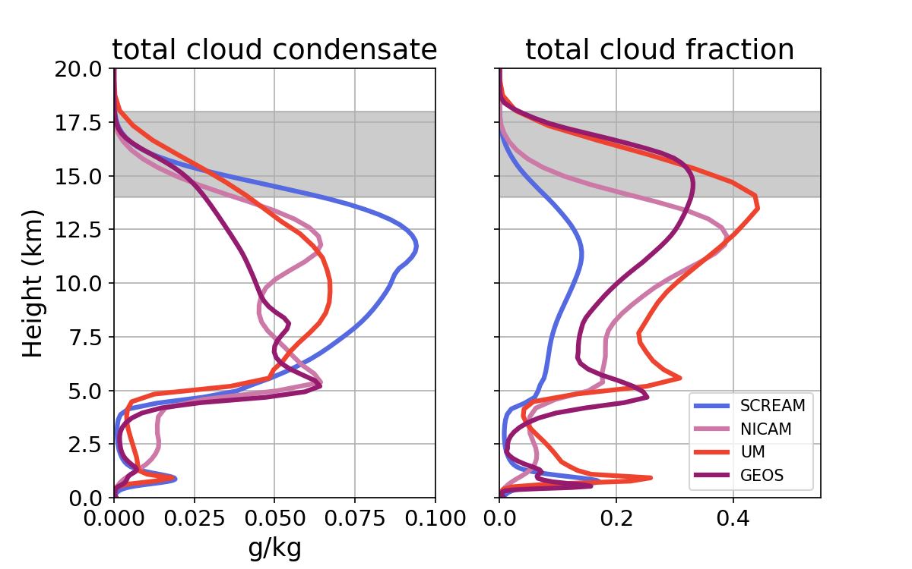
The differences in the vertical structure of clouds are reflected in the joint histogram
Models with total frozen condensate are shown
Notes:
Here, we are looking at the time and area mean of cloud mass on the left and cloud fraction on the right. I’ve shaded the tropical tropopause layer in gray because I said I’d be talking about high clouds.
Now, we’ll go through the models one by one and draw connections to what we saw in the Joint albedo OLR histogram. Let’s start with NICAM again.

Slide 11
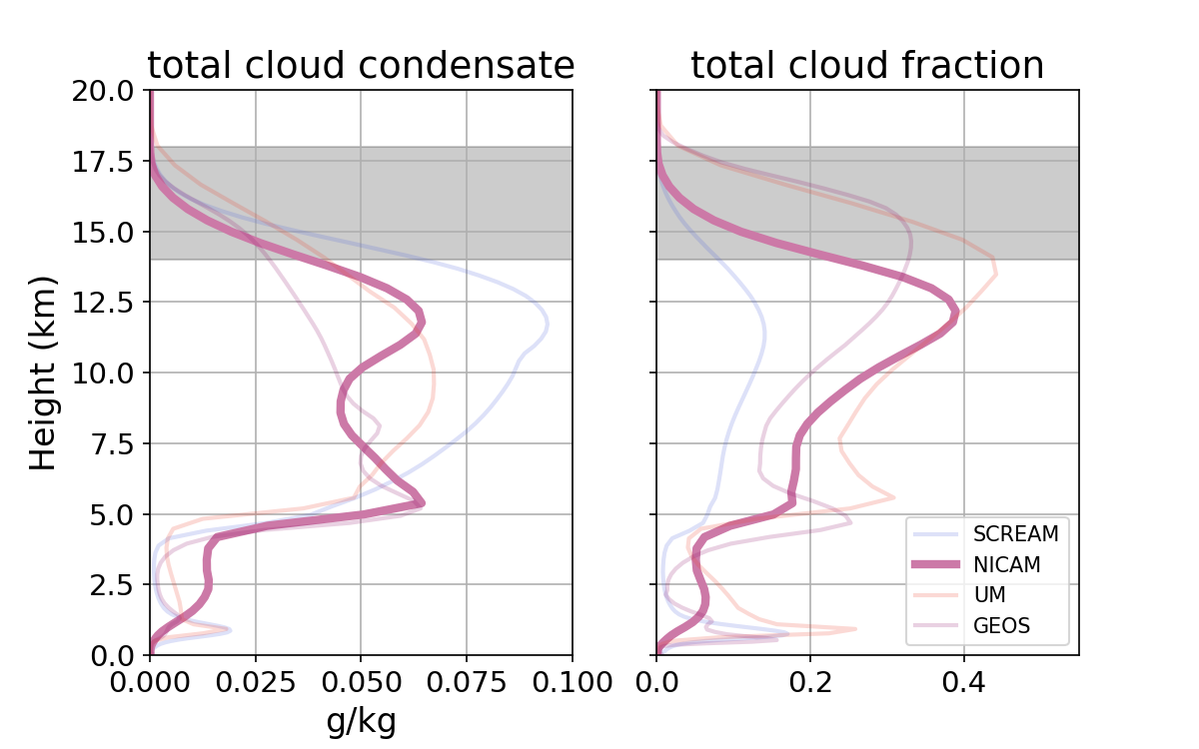
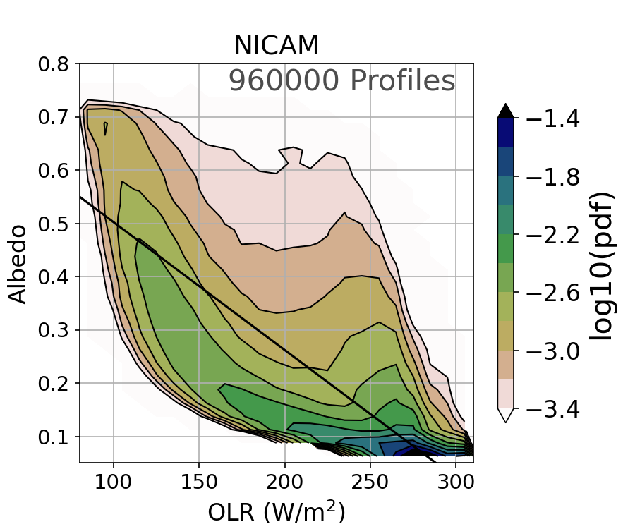
NICAM has a lot of upper-level cirrus
and thick “congestus” clouds
Models with total frozen condensate are shown
Notes:
NICAM has a lot of upper-level cirrus (peaking just below the tropical tropopause layer shaded in gray). It also has thicker clouds near the freezing level contributing to the congestus clouds we saw in the joint histogram.

Slide 12
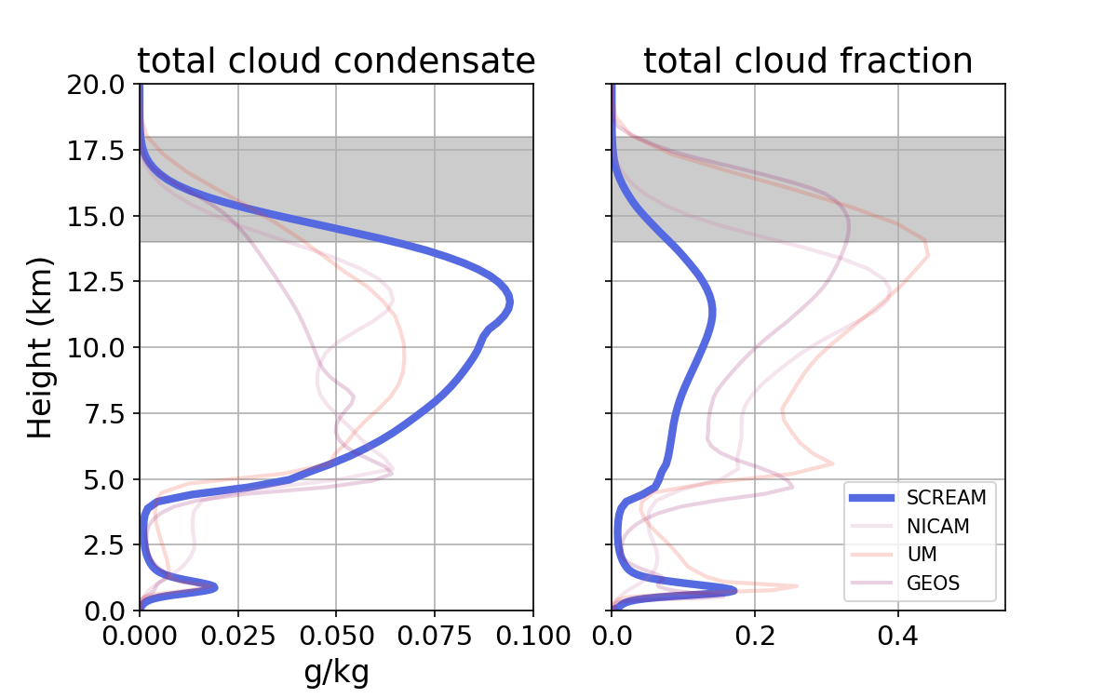
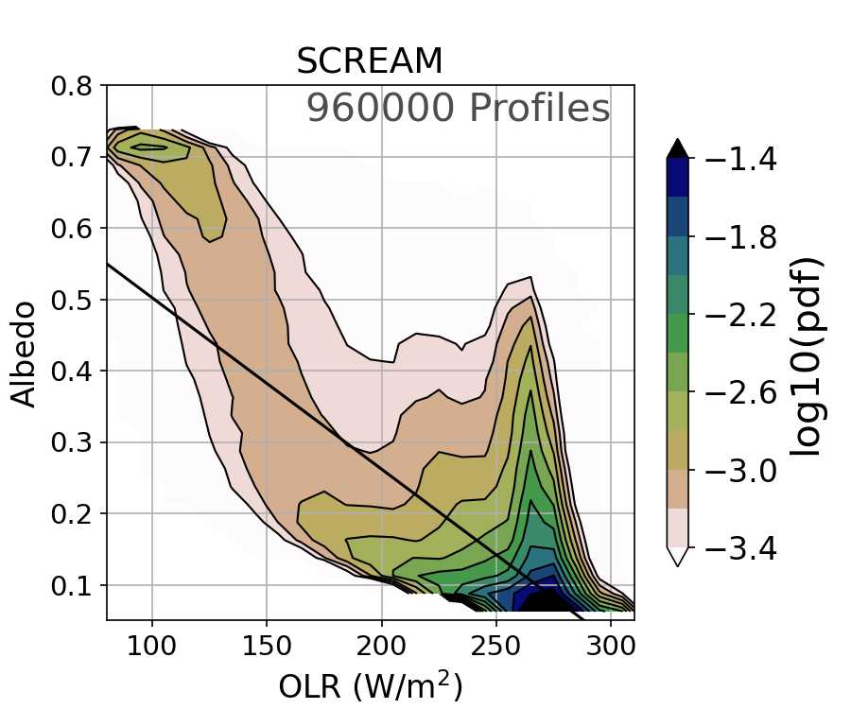
SCREAM has high ice mass “popcorn” convection
Models with total frozen condensate are shown
Notes:
SCREAM has high hydrometeor mass concentration but very few clouds, so it does not capture the balance between LW and SW in this region. We don’t see as many anvil cirrus in SCREAM which we suspected from the joint histogram and can see by the low cloud fraction in the upper troposphere

Slide 13
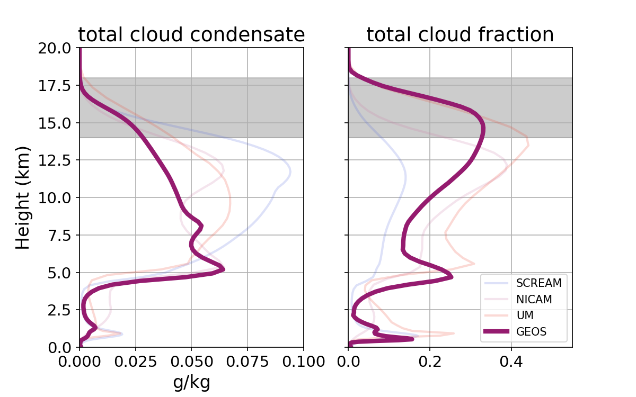
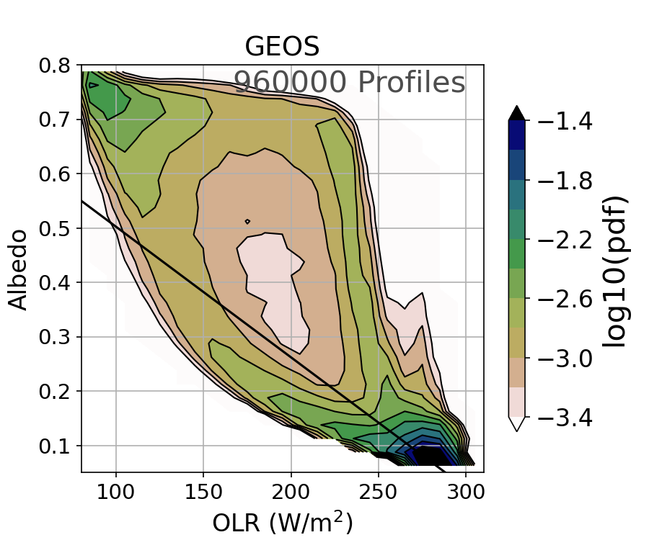
GEOS also has “popcorn” convection and
thicker “congestus” clouds
Models with total frozen condensate are shown
Notes:
GEOS also has popcorn convection like SCREAM but has slightly more anvil. GEOS is almost emphasizing this congestus population and provided a different pathway to/from deep convection. And we do see really thick clouds frequently reaching the freezing level.

Slide 14
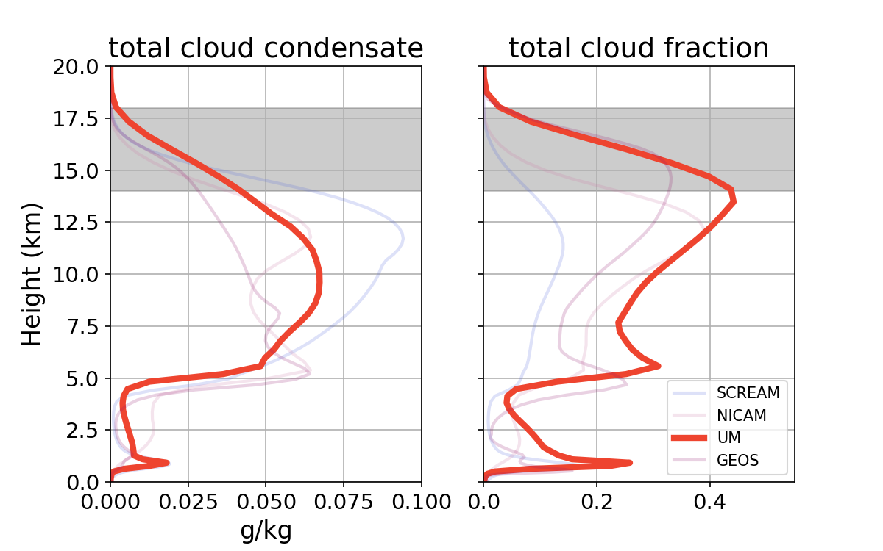
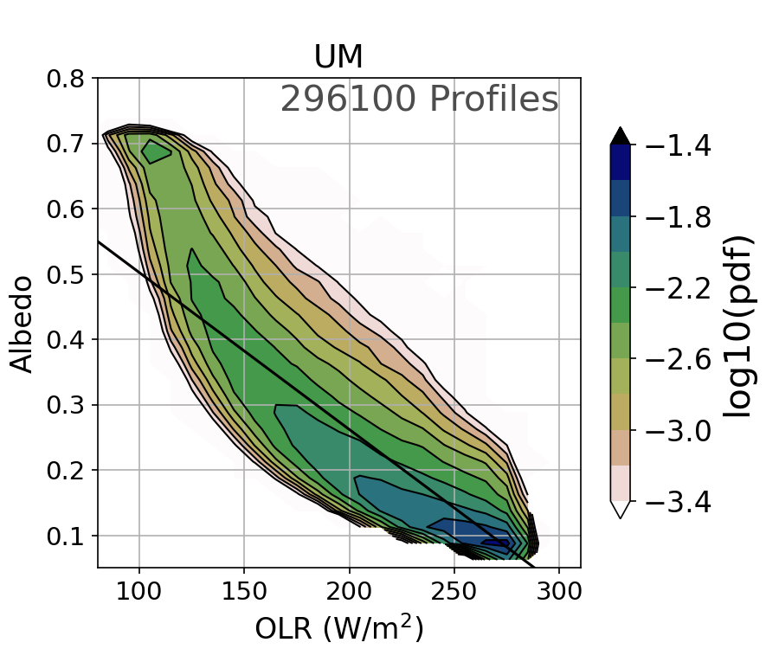
UM has a higher frequency of convection and anvil cirrus in the TTL
Models with total frozen condensate are shown
Notes:
UM has a higher frequency of convection than the other models with more anvils in the TTL. While we do see a peak in cloud fraction near the freezing level, we do not see a “congestus” population in the joint histogram. More work is needed to understand what is happening with these congestus clouds.
“Too warm, too moist” in UM – high cloud fraction with large hydrometeor mass

Slide 15
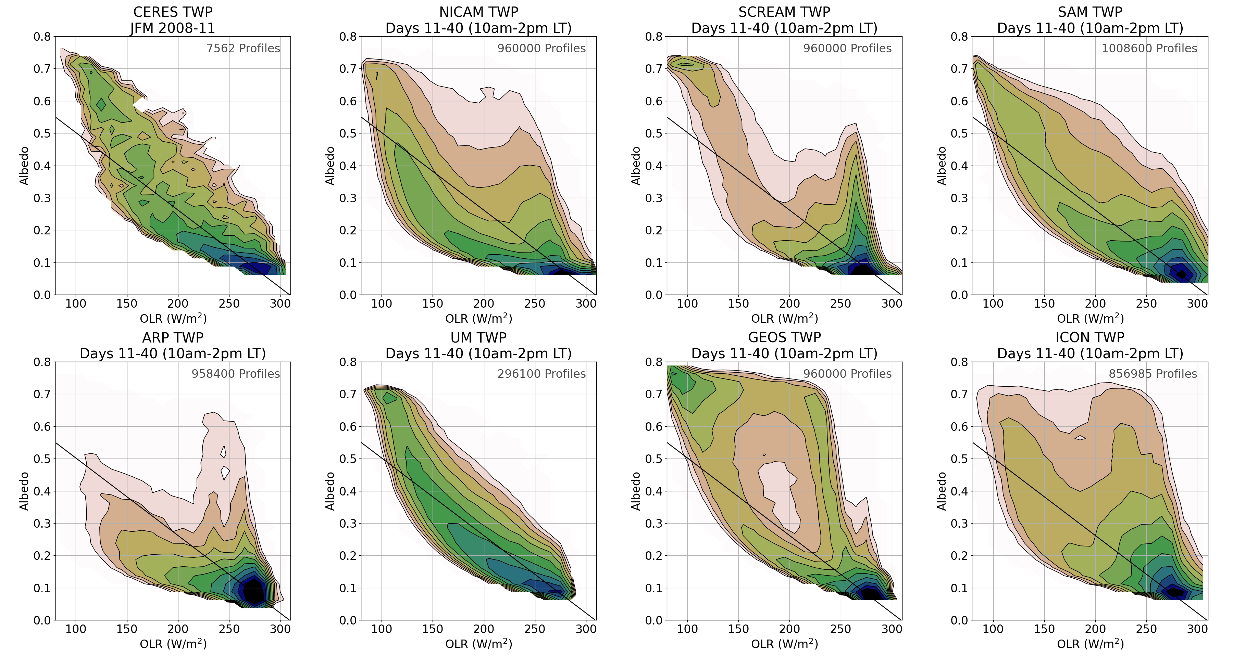
Differences are driven by differences in model microphysics and dynamics
Models with total frozen condensate are shown
Notes:
To summarize, the models are providing a wide array of behaviors in the vertical structure – the differences are reflected in the joint histograms. We think that these differences are driven by model microphysical and dynamical differences and maybe to a smaller extent thermodynamic differences. We are planning on work to get at which processes in these models are more important for driving anvil and cirrus cloud life cycle. microphysics or dynamics drivers

Slide 16
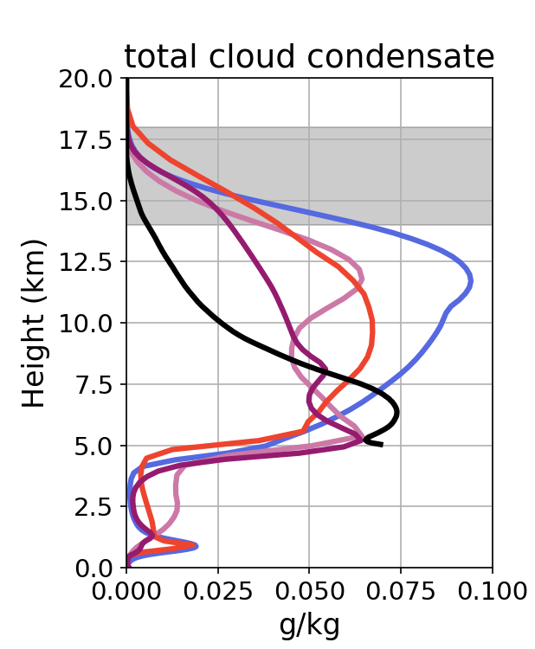
Future work
SCREAM
Effect of microphysics on tropical cirrus using a variable resolution version of SCREAM
Summary
The DYAMOND models reasonably reproduce tropical convection as seen through the joint histogram
Large differences in cloud populations are driven by model microphysics and dynamics
Turbeville et al., 2022, ESS
smturbev@uw.edu
Thank you!
Notes:
Specifically in the near future we are thinking about using a variable resolution of SCREAM (so it’s a more management amount of data) to understand the microphysics effect of tropical cirrus. We are also planning a warmed run. Still very much in brainstorming phase – please come find me after if you have thoughts.
In summary, I hope I have convinced you that studying GSRMs are fascinating and a productive use of time and resources. We have seen that DYAMOND reasonably reproduces convection as seen through the joint histogram. And that larges differences are driven by model microphysics and dynamics. When we understand these biases we can use the models to ask and hopefully answer all types of science questions,
which we would have a hard time getting at from observations, GCMs or regional models alone.
Thank you!

