Slide 1
Introducing Flashiness-Intensity-Duration-Frequency (F-IDF) Curve: A New Metric to Quantify Flash Flood Intensity
Jonathan J. Gourley
NOAA, Office of Oceanic and Atmospheric Research
National Severe Storms Laboratory, Norman, OK
Zhi Li and Yang Hong
University of Oklahoma, Norman, OK, USA
GEWEX 1st GLOBAL FLOOD CROSSCUTTING PROJECT WORKSHOP 22 Sept 2023

Slide 2
Motivating questions
How to identify basins, parts or the country, or world that are “flashy” and thus respond quickly to rainfall and with high magnitudes?
If flashiness variable(s) can be identified using observed discharge, can they be used in a forecasting context? How about at ungauged locations?
Proposal: Compute Flashiness-Intensity-Duration-Frequency (IDF) curves
Apply to observed discharge data using USGS gauges
Extend concept to ungauged pixels across entire US
GEWEX 1st GLOBAL FLOOD CROSSCUTTING PROJECT WORKSHOP 22 Sept 2023

Slide 3
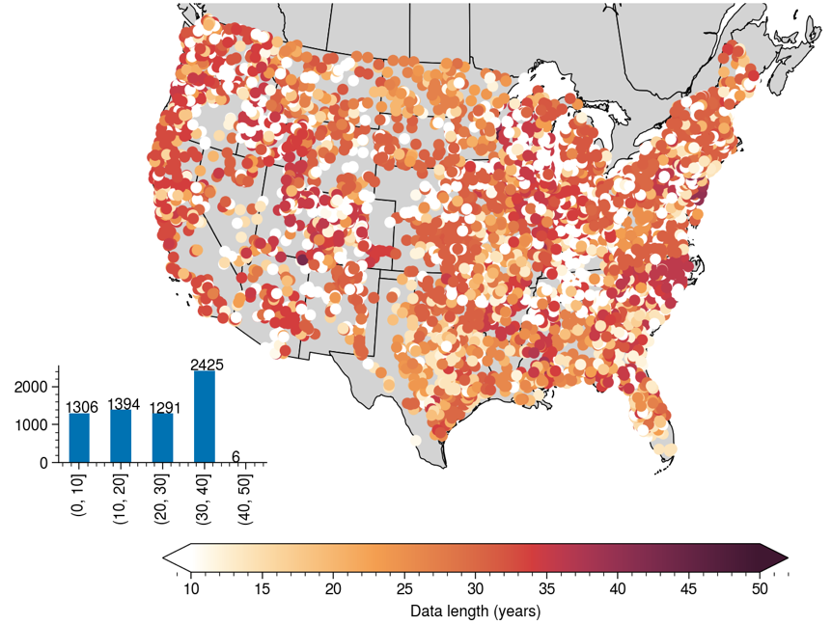
Data record length for USGS gauges
Discharge data available at 5,116 gauges
15-min resolution
GEWEX 1st GLOBAL FLOOD CROSSCUTTING PROJECT WORKSHOP 22 Sept 2023

Slide 4
Fit extreme value distribution
Find maximum slope of hydrograph (flashiness) over a moving time window (D=1-6 hr)
Extract the annual maximum
Fit into general extreme value distribution and logPearson Type III distribution
Find an optimal fit based on the BIC (Bayesian Information Criterion)
Find flashiness values at different frequency 2, 5, 10, 25, 50 and 100-y
GEWEX 1st GLOBAL FLOOD CROSSCUTTING PROJECT WORKSHOP 22 Sept 2023
Notes:
Flashiness – assess geomorphological factors (basin scale, etc.)
Add to 12, 24-hour
Modeling component

Slide 5
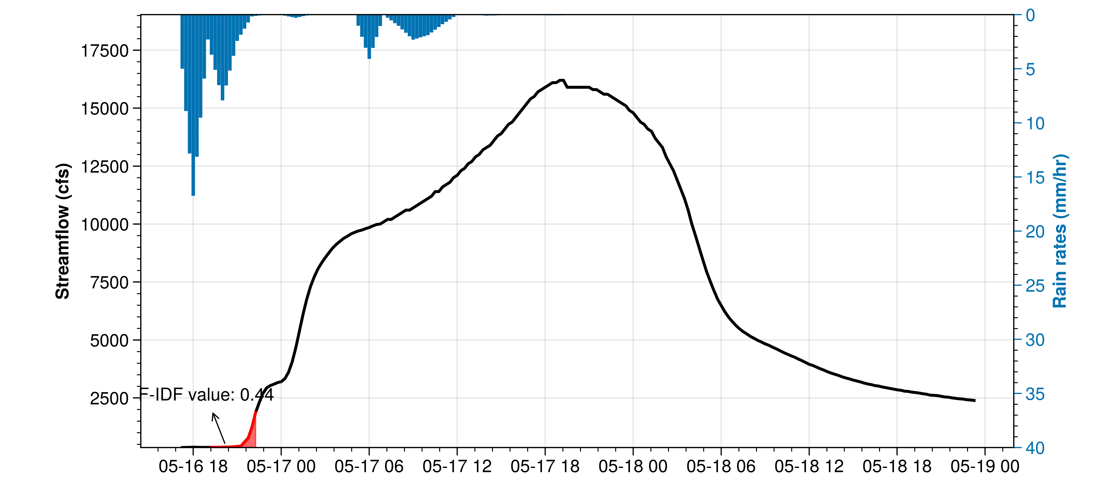
Illustration – 3-hr Flashiness Computation
GEWEX 1st GLOBAL FLOOD CROSSCUTTING PROJECT WORKSHOP 22 Sept 2023

Slide 6
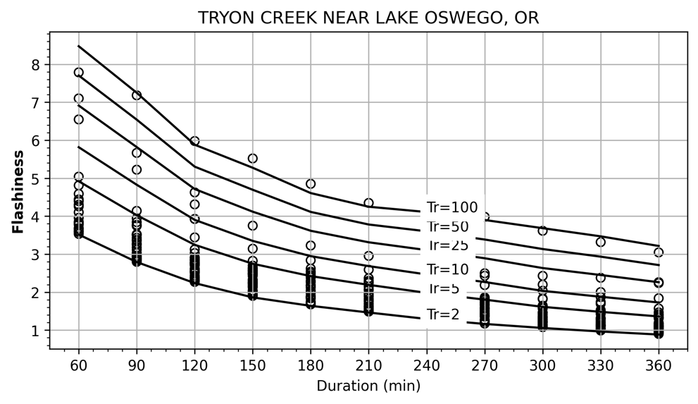
Flashiness-Intensity-Duration-Frequency (F-IDF) curve
GEWEX 1st GLOBAL FLOOD CROSSCUTTING PROJECT WORKSHOP 22 Sept 2023

Slide 7
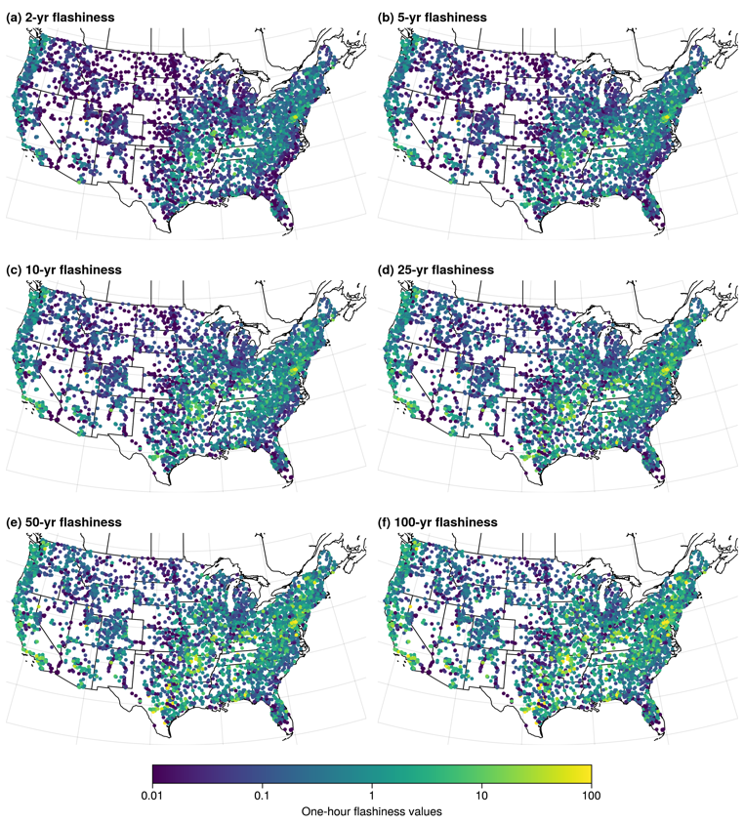
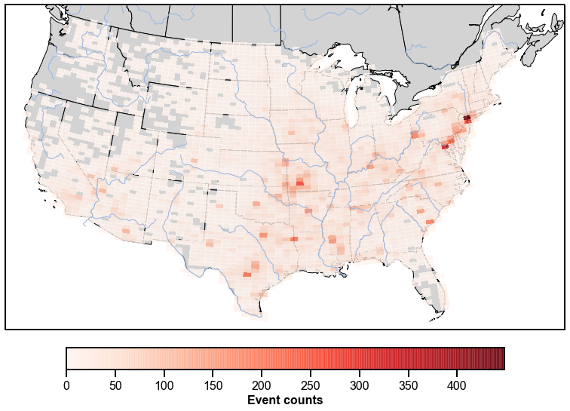
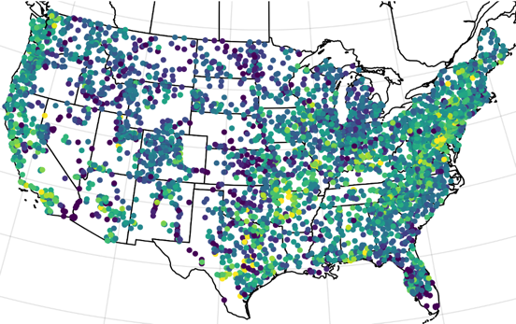
Frequency of flashiness values for 1-hr duration
①
②
③
⑤
④
Flash flood occurrence density plot (based on National Weather Service Storm Data)
GEWEX 1st GLOBAL FLOOD CROSSCUTTING PROJECT WORKSHOP 22 Sept 2023
Notes:
Cluster into regions and show representative curves
Show the added values of duration (example)
Effects of human control on flashiness

Slide 8
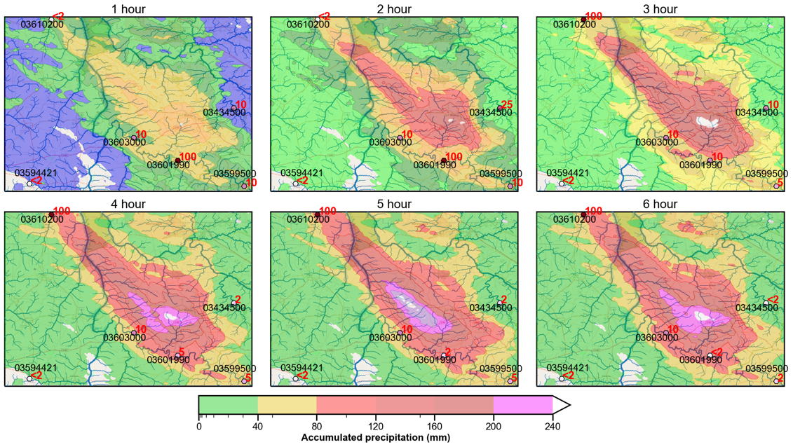
2021 Tennessee flash flooding
GEWEX 1st GLOBAL FLOOD CROSSCUTTING PROJECT WORKSHOP 22 Sept 2023

Slide 9
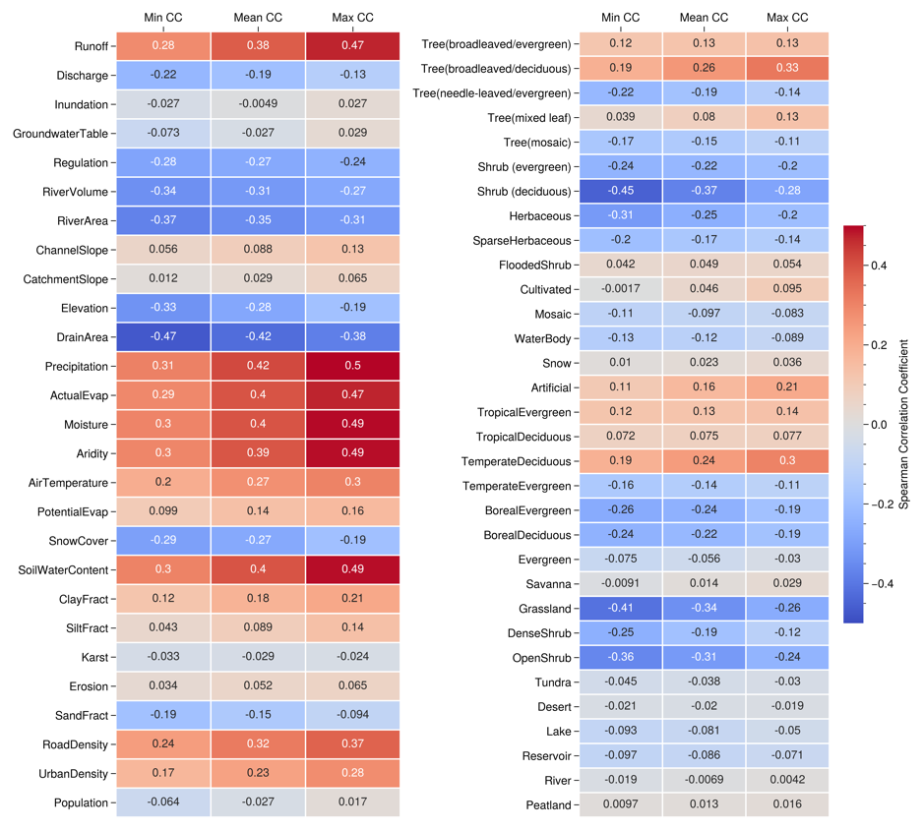
Factors
Hydrology
↑ Flashiness -> ↓ discharge, river area/volume: small reaches tend to have higher flashiness values
↑ Flashiness -> ↓ regulation: flood structures impede flash floods
↑ Flashiness -> ↑ land runoff, air temperature, aridity index, evaporation, climate moisture index: flashiness is a weather-dependent variable not dependent on climate
↑ Flashiness -> ↓ snow cover extent: flash floods are not typically snow-driven
↑ Flashiness -> ↑ clay, ↓ sand: clay soils help generate flash floods
↑ Flashiness -> ↑ soil water content: wet soils help generate flash floods
↑ Flashiness -> ↑ urban density, road density: impervious surface area help generate flash floods
Land Cover
Physiography
Climate
Natural Vegetation
Soils & Geology
Human
Wetland
Notes:
Which factor explains at different frequency
Land cover

Slide 10
Developing distributed F-IDF curves at all pixels in the US
GEWEX 1st GLOBAL FLOOD CROSSCUTTING PROJECT WORKSHOP 22 Sept 2023

Slide 11
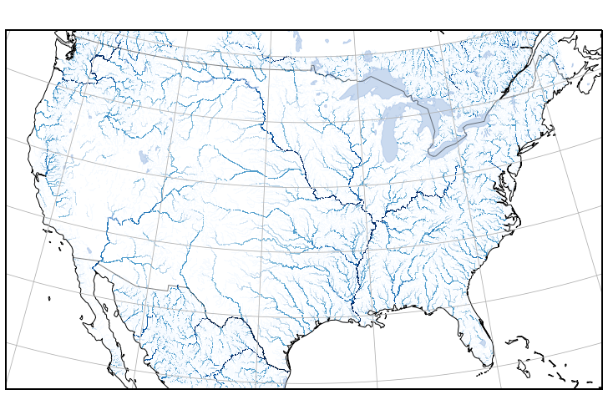
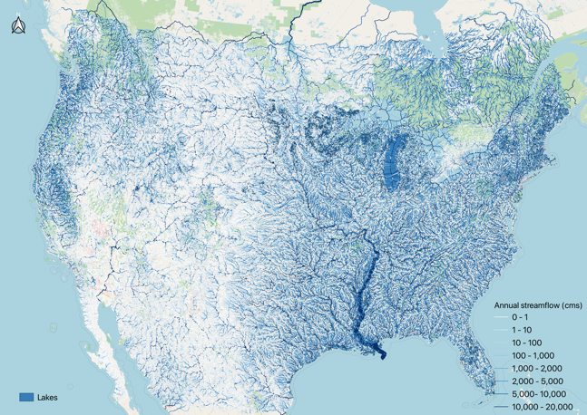
Cross-compare
CREST-based FIDF
(gridded)
MRMS reanalysis precipitation data
RiverAtlas data
ML-based FIDF
(reach-based)
Pre-calibrated parameters
CREST hydrologic model
59 attributes
Streamflow from 2001-2012 @ 1km/15 min
Training/testing
20 ML models
Gage-based FIDF
Calculate annual max. flashiness
Extrapolation
556,711 CONUS river reaches
Fit Extreme Value Distribution
Dynamic (event-based)
Static
Validate
Gage-based FIDF
GEWEX 1st GLOBAL FLOOD CROSSCUTTING PROJECT WORKSHOP 22 Sept 2023

Slide 12
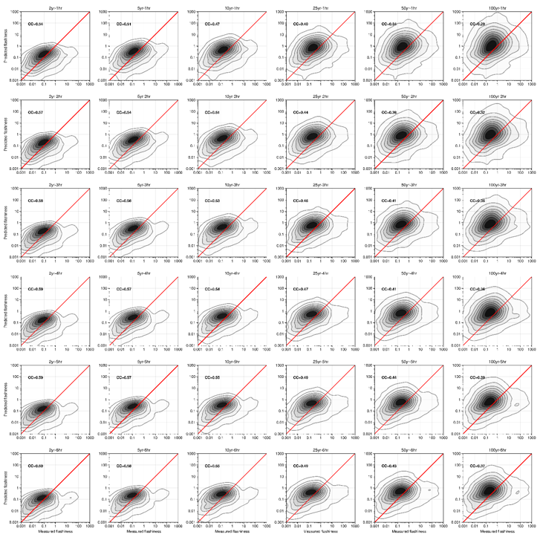
Duration
1 hr
2 hr
CREST-based testing
Best correlations (0.6) for long-duration (6 hr), low return period (2 y) events
Model shows tendency to overpredict weak events and underpredict the biggest ones
Given model is using a-prior parameters, results are deemed acceptable
3 hr
4 hr
5 hr
6 hr
Return period
2 y
5 y
10 y
25 y
50 y
100 y
GEWEX 1st GLOBAL FLOOD CROSSCUTTING PROJECT WORKSHOP 22 Sept 2023

Slide 13
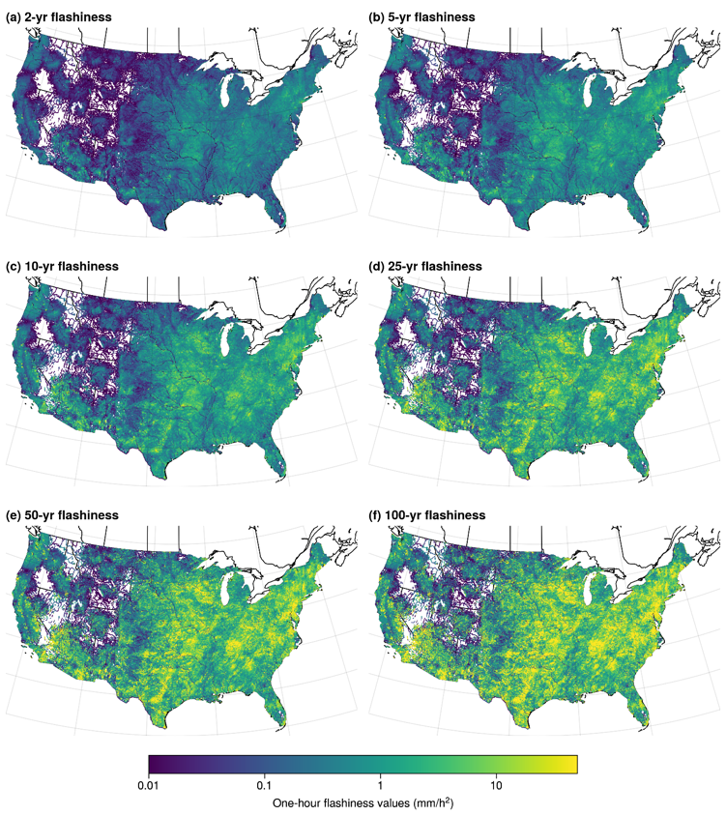
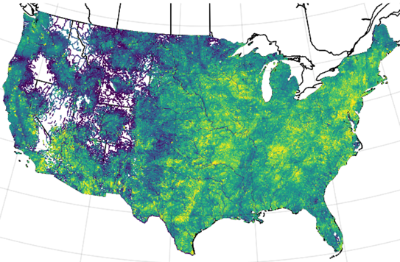
CREST-based distributed F-IDF
Flash flood occurrence density plot (based on Storm Events)
GEWEX 1st GLOBAL FLOOD CROSSCUTTING PROJECT WORKSHOP 22 Sept 2023
Notes:
Cluster into regions and show representative curves
Show the added values of duration (example)
Effects of human control on flashiness

Slide 14
Summary and Outlook
Extreme or “flashy” hydrologic response is quantified by the slope of the rising limb of the hydrograph
We computed IDF curves of the flashiness variable at all available USGS stations
The same methodology was applied to simulated hydrographs using a reanalysis precipitation dataset input to a hydrologic model, yielding F-IDF curves at all grid points
Grids of flashiness are being provided to National Weather Service forecasters to provide an initial background map for regions that need more careful monitoring
Real-time forecasts of flashiness are being considered as another tool for forecasters
F-IDF curves at USGS gauges:
https://zenodo.org/record/7806694
F-IDF curves over CONUS:
https://zenodo.org/record/8169330
Contact: jj.gourley@noaa.gov
GEWEX 1st GLOBAL FLOOD CROSSCUTTING PROJECT WORKSHOP 22 Sept 2023

