Slide 1
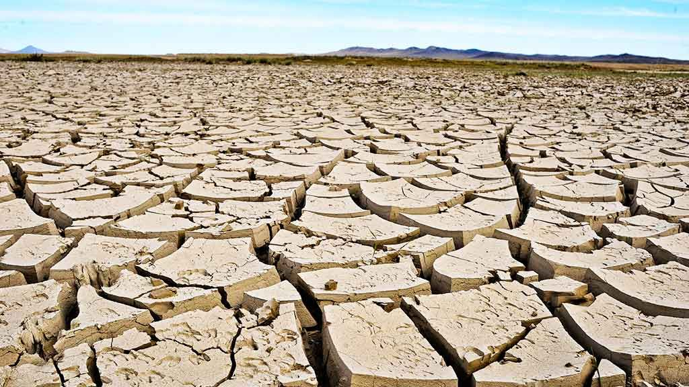
Agricultural drought over water-scarce Central Asia
Jie Jiang, and Tianjun Zhou
Institute of Atmospheric Physics, Chinese Academy of Sciences
3rd Workshop on Central Asia, Apr 29 – May 1, 2024, Osh, Kyrgyz Republic
Notes:
Hello everyone, I am Jie Jiang from the Institute of Atmospheric Physics. Today, I am going to introduce my recent work on agricultural drought over Central Asia.

Slide 2
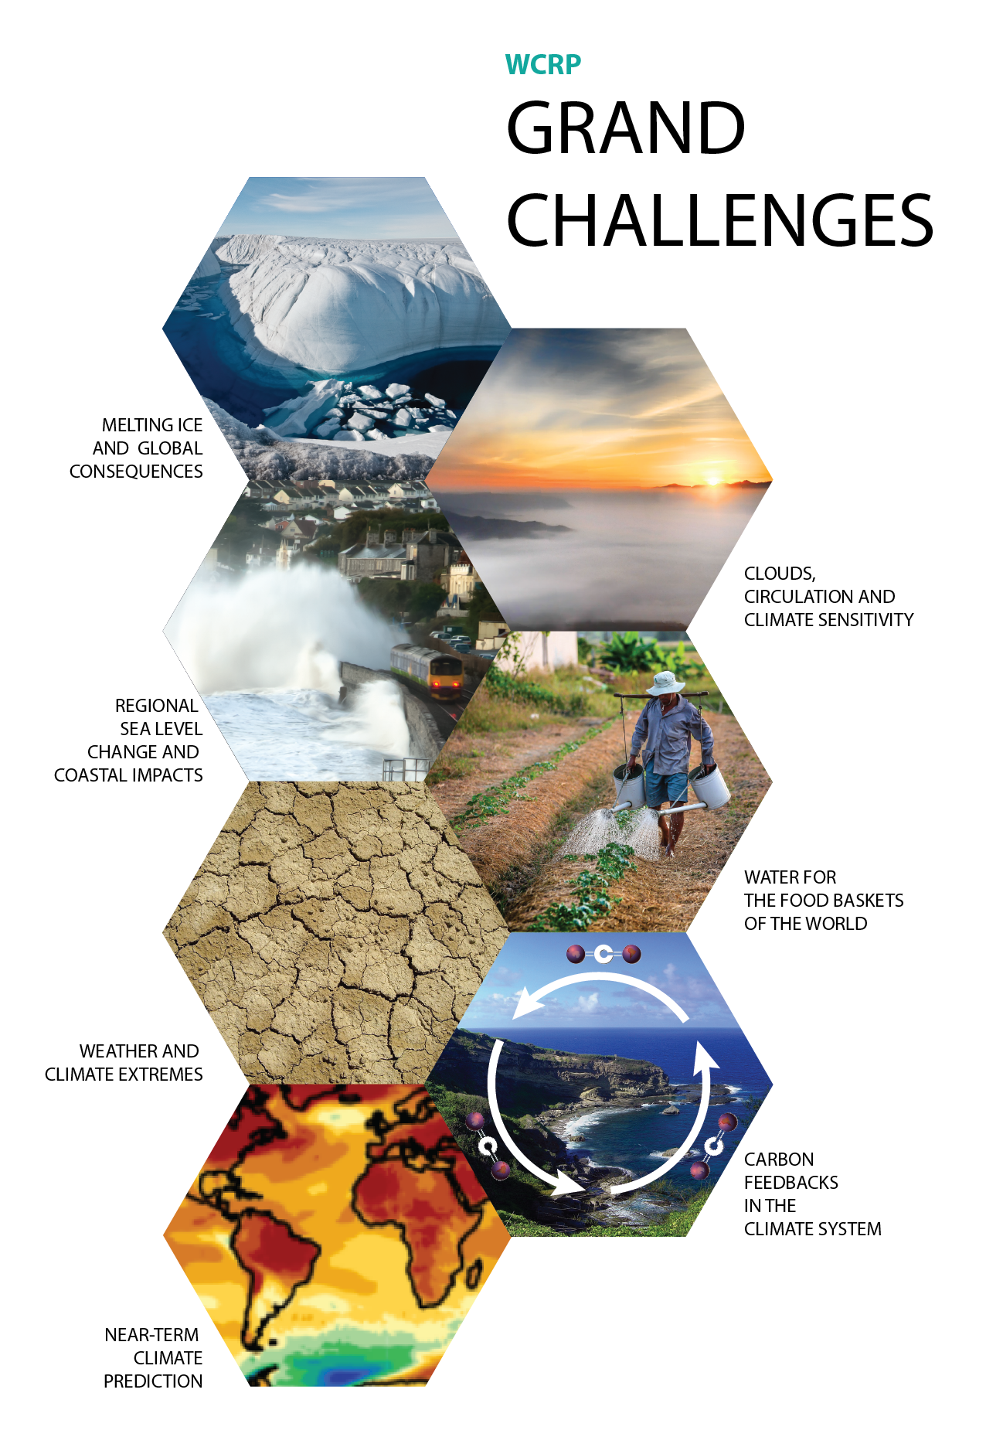
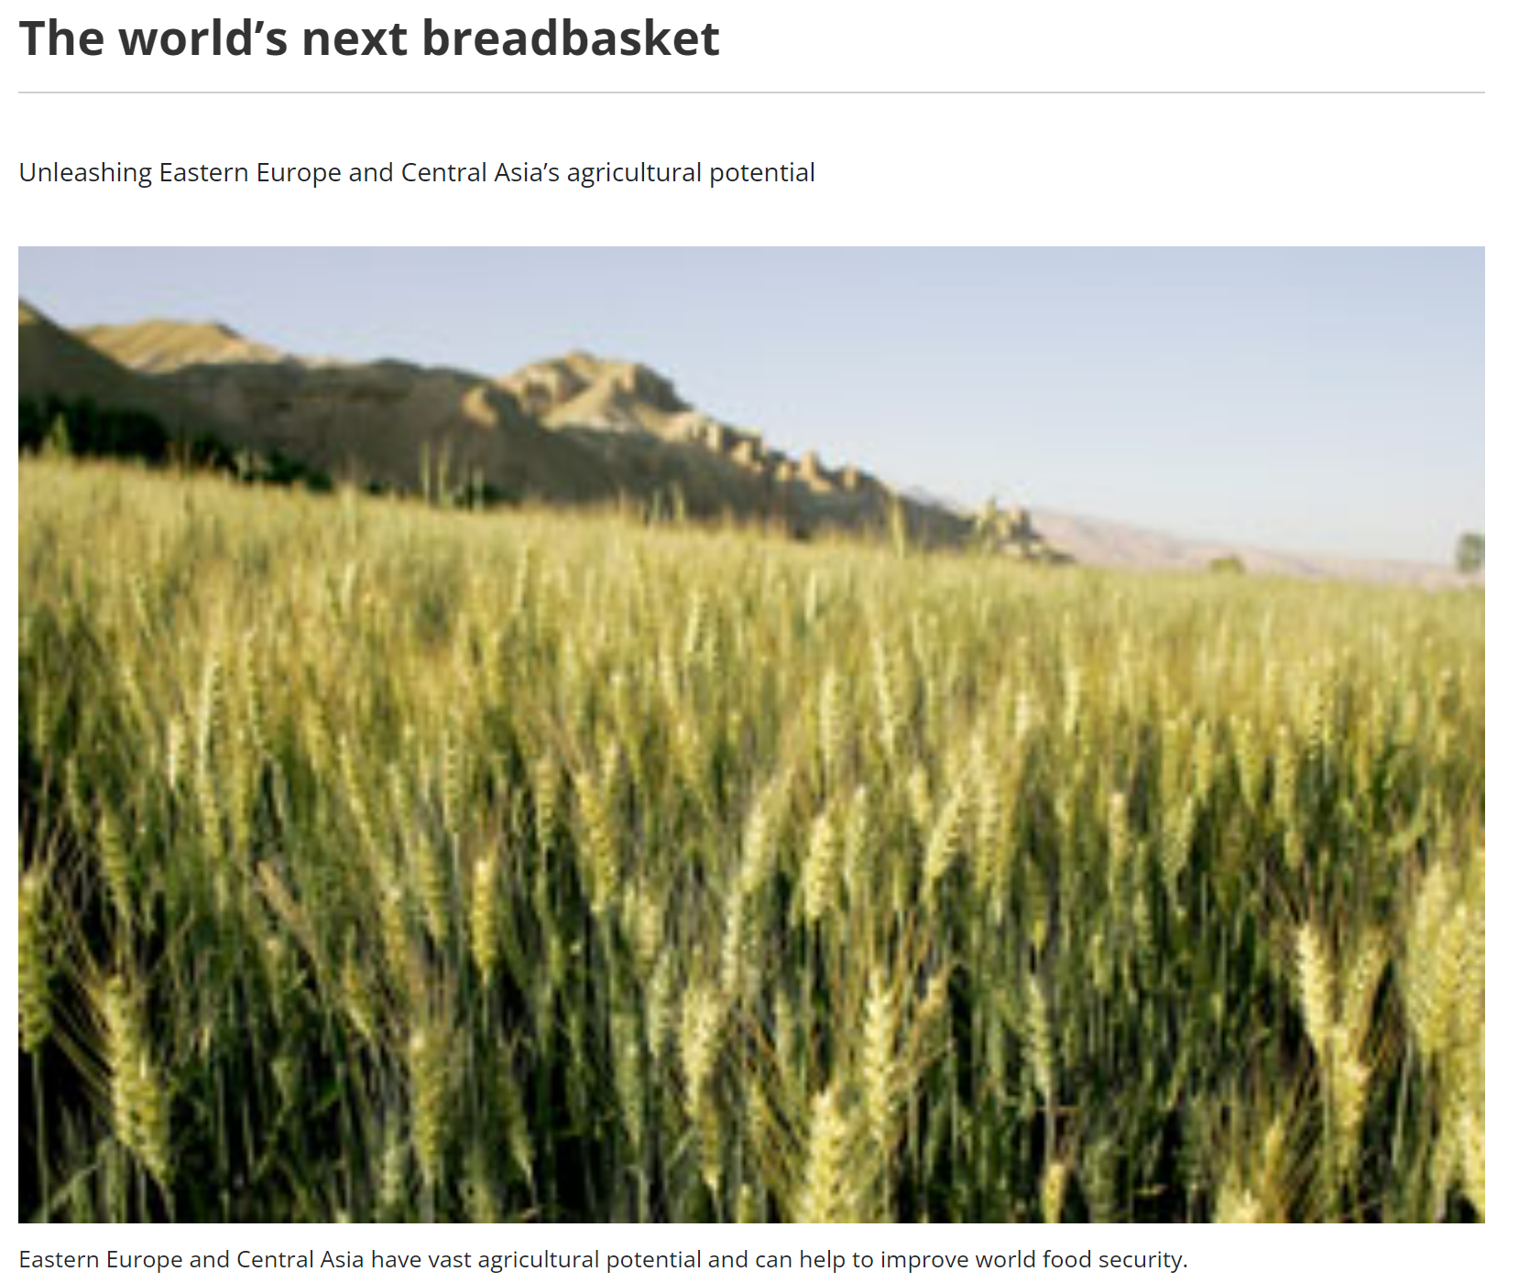
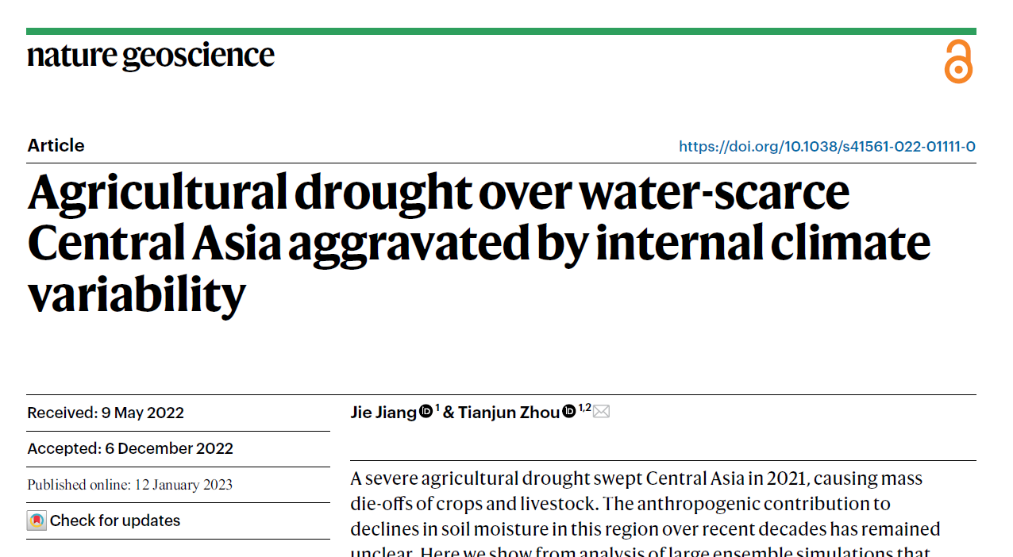
Agricultural drought over water-scarce Central Asia
1
2
3
Why to study it
What we have done
What should we do
IAP Institute of Atmospheric Physics, Chinese Academy of Sciences

Slide 3
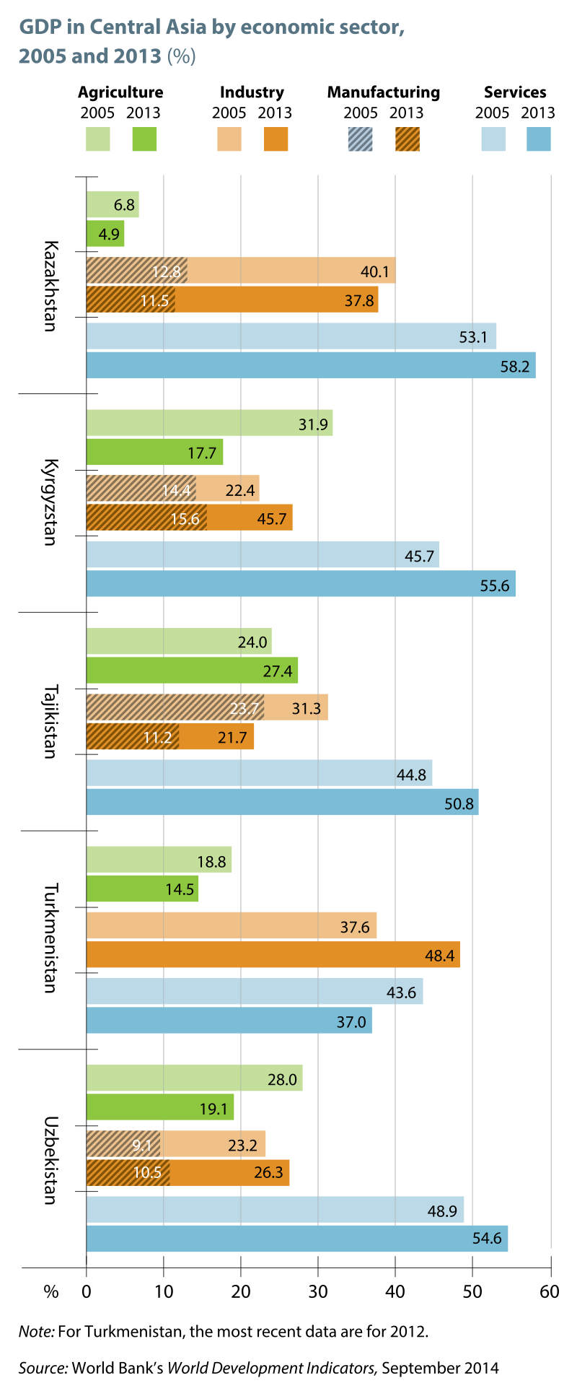
Why to study it ?
GDP in Central Asia by economic sector
Central Asian economic relies on primary industries including agriculture
Central Asia has the potential to be the world’s next breadbasket
IAP Institute of Atmospheric Physics, Chinese Academy of Sciences
Notes:
Central Asian economic rely on primary industries including agriculture. This is the GDP in Central Asia by economic sector, we can see agriculture, the green one, occupies nearly 20% of the GDP for most of Central Asian countries.
Food and Agriculture Organization of the United Nations also suggest that Central Asia has the potential to be the world’s next breadbasket.

Slide 4
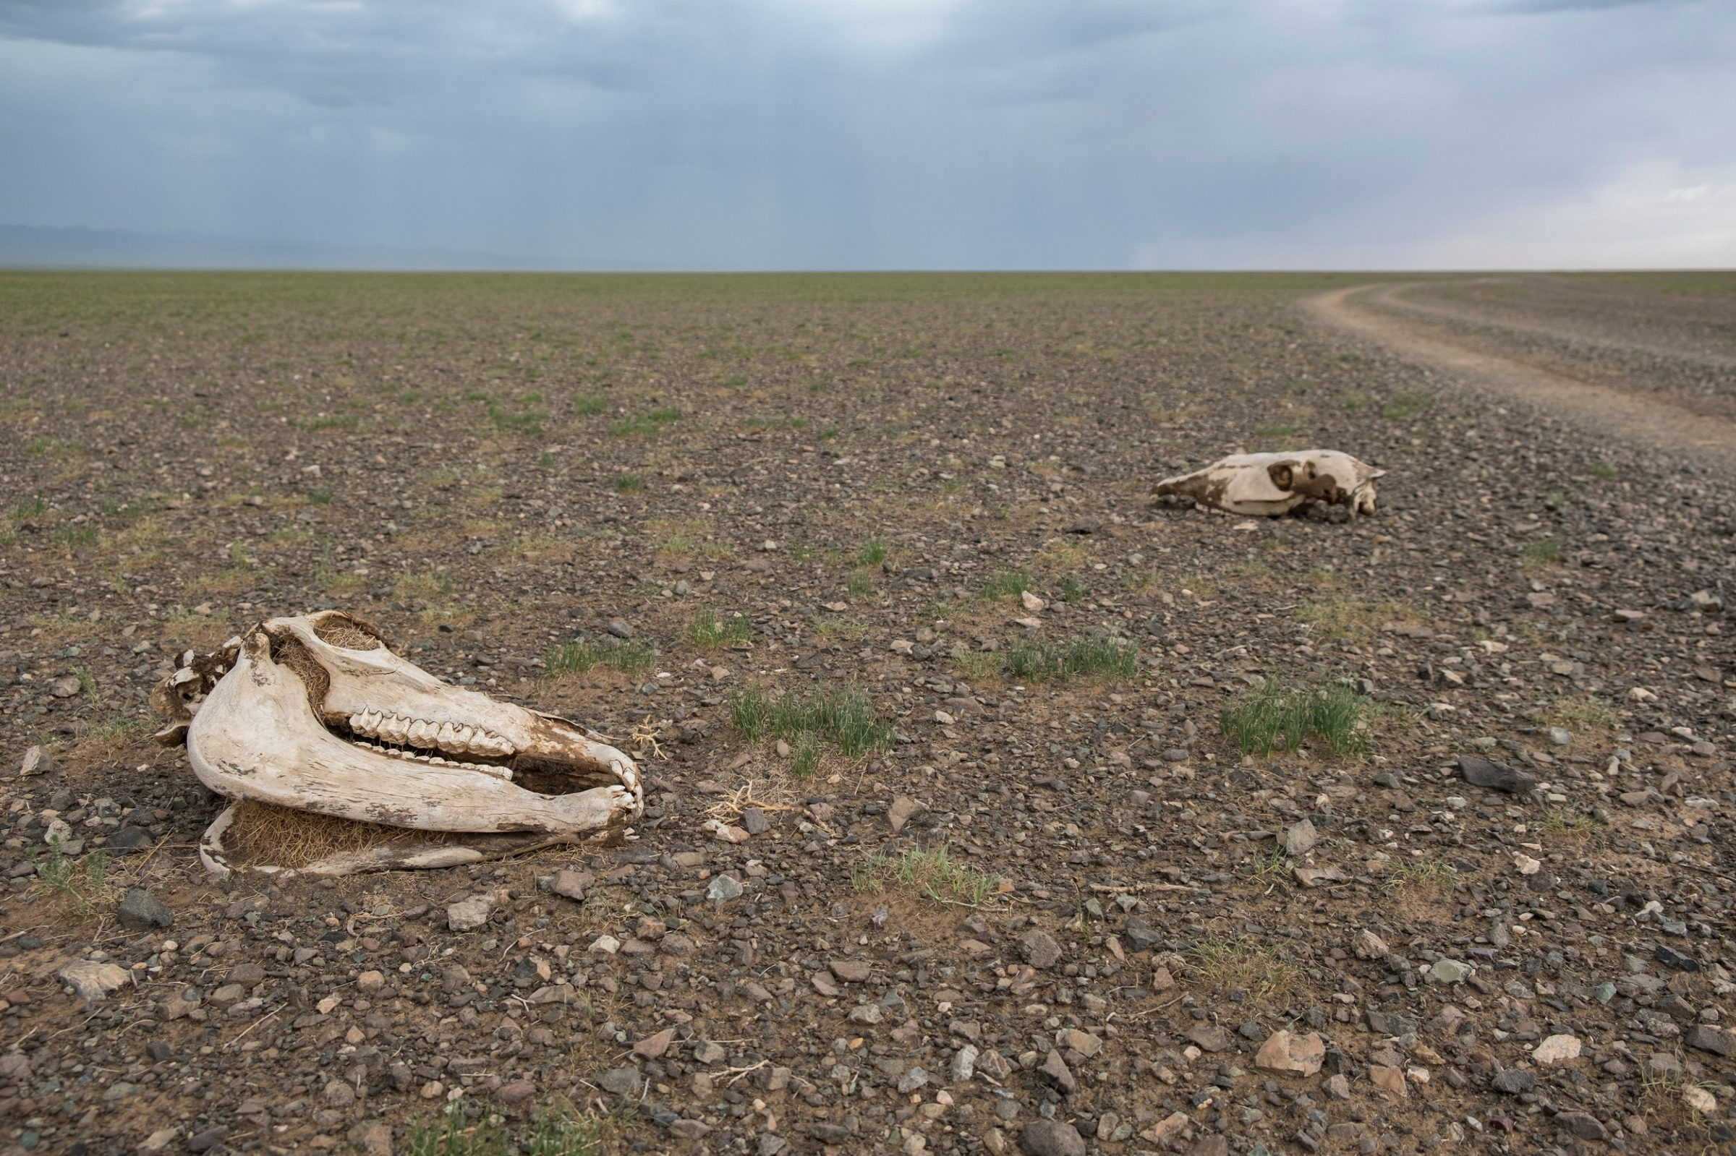
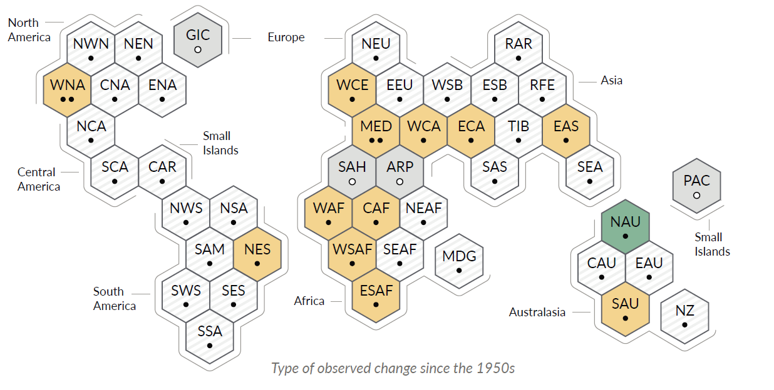
Why to study it ?
A severe agriculture drought in 2021
Observed changes in agriculture drought since the 1950s
https://www.thethirdpole.net/en/climate/drought-central-asia-water-crisis/
IPCC AR6 2022
Climate change is already affecting agriculture drought and food production
IAP Institute of Atmospheric Physics, Chinese Academy of Sciences
Notes:
But Central Asia has suffered from a severe agriculture drought in 2021 in its early growing season.
The harsh drought of 2021 is not an independent event but a part of a dryer trend over the past half century. And IPCC AR6 reports that most of the regions in the world including Central Asia is under the threat of food production under climate change. There is a growing concern regarding the detection and attribution of long-term changes in agriculture drought.

Slide 5
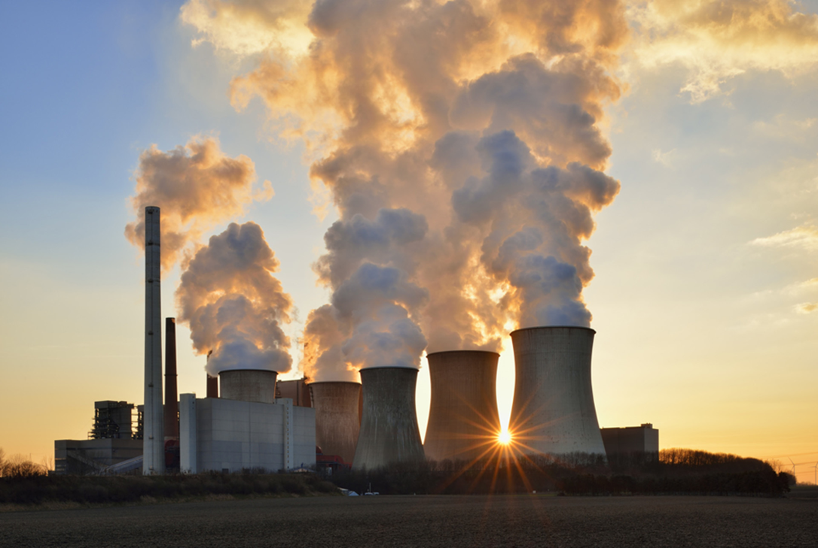
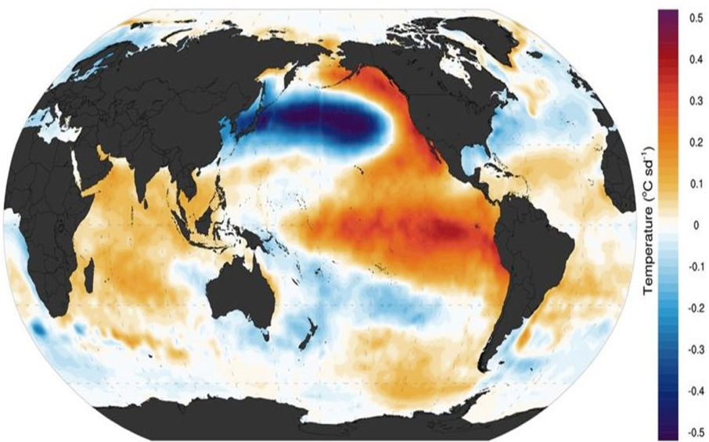
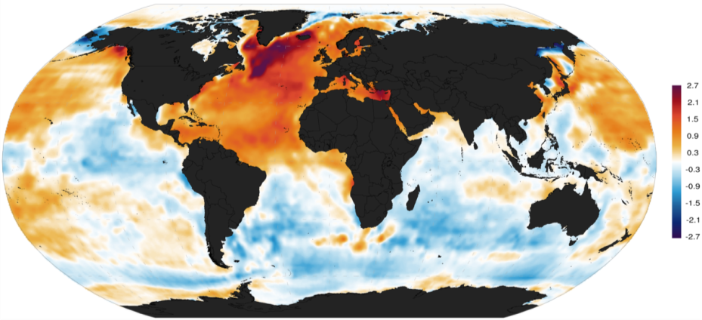
What we have done ?
Detection & Attribution
IAP Institute of Atmospheric Physics, Chinese Academy of Sciences
Notes:
Here we hope to answer the following two question, how external forcing and internal variability affect agriculture drought over Central Asia. And how will agriculture drought changes in the future

Slide 6
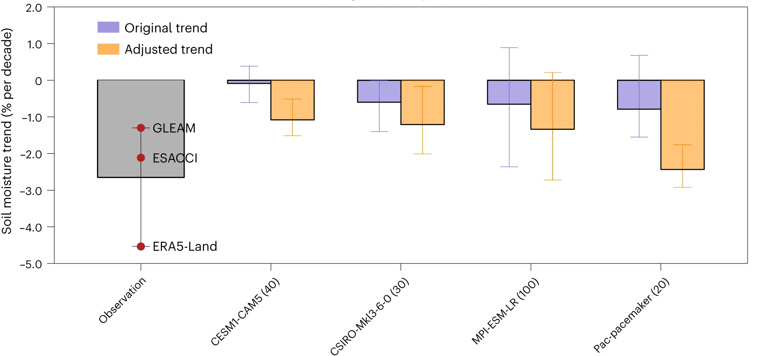
What we have done ?
ERA5-Land: AMJ soil moisture trend (1992-2020)
Obs+Model: AMJ soil moisture trend (1992-2020)
External forcing
External forcing + IPO
Human-induced warming could lead to the increased evapotranspiration and decreased soil moisture
The positive-to-negative phase transition of interdecadal Pacific oscillation has doubled the externally forced rate of drying in the early growing season during 1992-2020.
IAP Institute of Atmospheric Physics, Chinese Academy of Sciences
Notes:
The human-induced warming could lead to increased evapotranspiration and decreased soil moisture. But we could also notice that the simulated drying trend is far weaker than the observation
After 1990s, there is positive to negative transition of the IPO, which could lead to reduced spring rainfall across southern Asia through two wave trains, and influencing water vapor transport from Indian Ocean. The decrease in precipitation in spring could further lead to a subsequent decrease in soil moisture in its early growing season.
We also quantified the contributions of external forcing and IPO based on an adjustment method. In short, we replace the original simulated IPO-related soil moisture trend with than induced by observed IPO evolution. The purpled bars denote the trend for the original ensemble mean, which is induced only by external forcing, the orange bars denote the adjusted trend, which is induced by both external forcing and observed IPO phase transition. The positive-to-negative phase transition has doubled the externally forced rate of dyring.

Slide 7
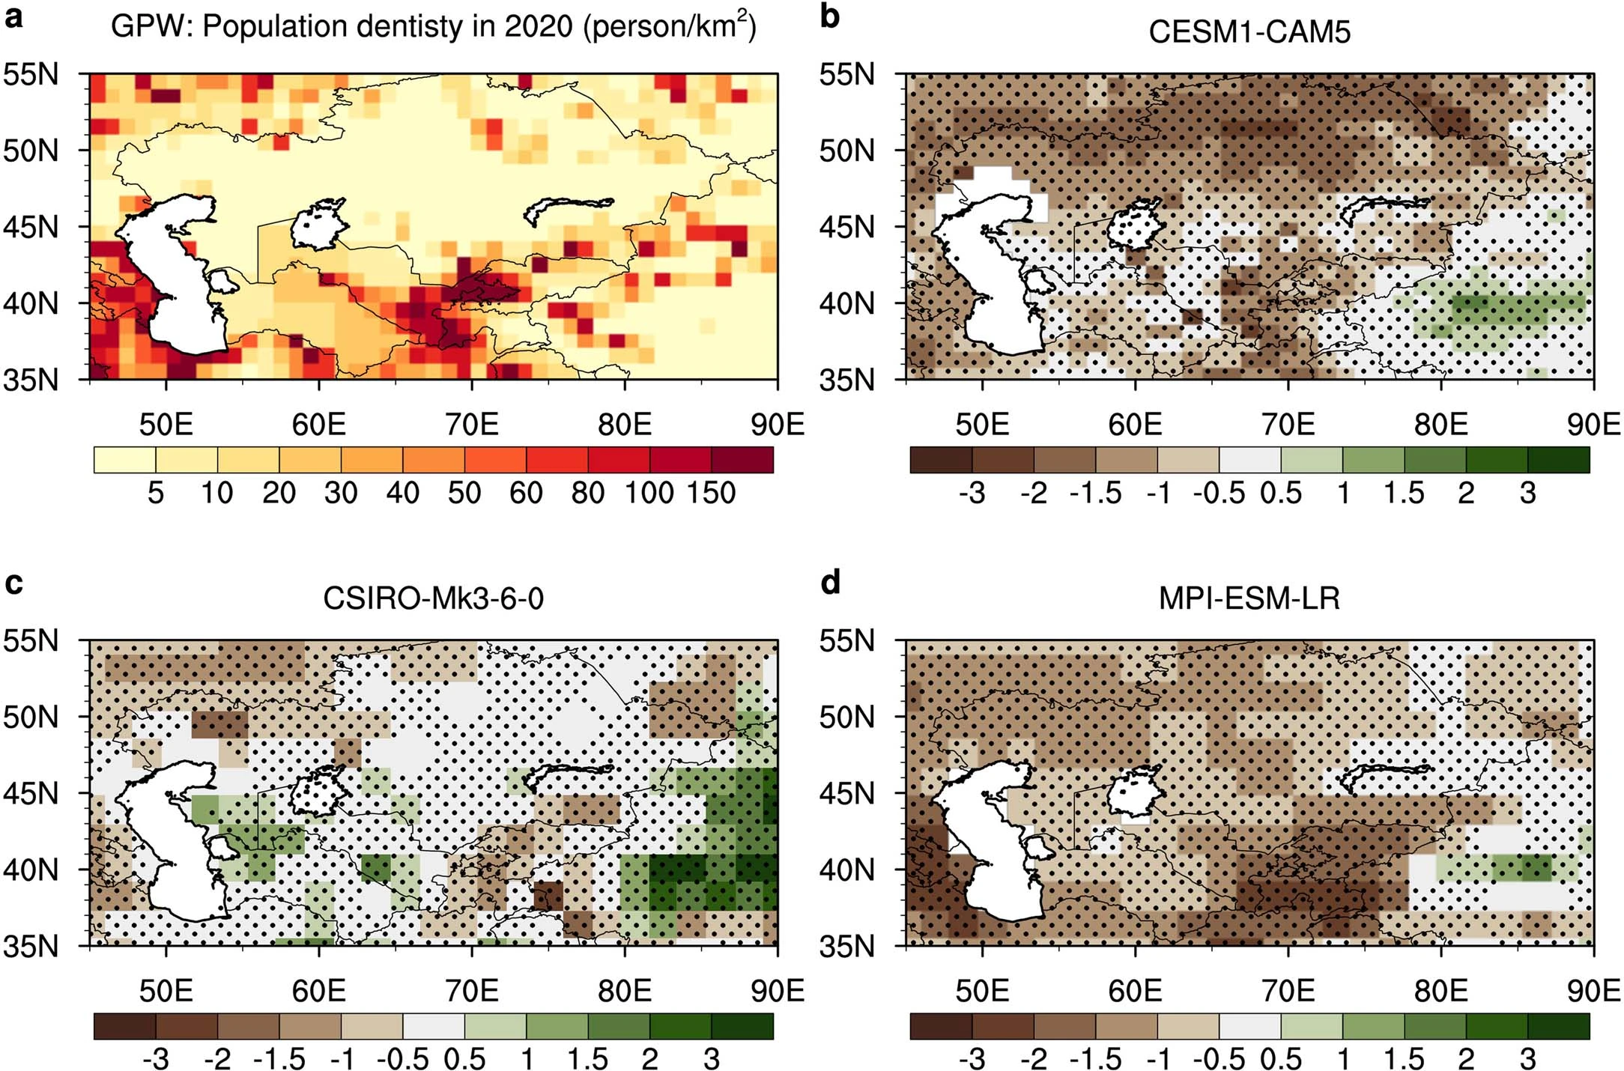
What we have done ?
Soil moisture trends during 2021-2100
Human-induced soil moisture loss will probably be further aggravated in the following century due to warming
IAP Institute of Atmospheric Physics, Chinese Academy of Sciences
Notes:
We further investigate the roles of different drivers on agriculture drought in the future. And here are the response to external forcing. We can find a widespread drying trend over Central Asia, especially the southeastern region. Some previous studies have pointed out that there is an increase in spring precipitation over Central Asia under global warming. However, because of strong evapotranspiration, there is still a reduced soil moisture in future.

Slide 8
What we have done ?
Soil moisture trends during 2021-2040
An amplitude of −2 standard deviation of the IPO trend is projected to amplify the externally forced decrease in surface soil moisture by nearly 75% in near-term
An amplitude of +2 standard deviation of the IPO trend is projected to weaken the externally forced decrease in surface soil moisture by nearly 60% in near-term
IAP Institute of Atmospheric Physics, Chinese Academy of Sciences
Notes:
The near-term externally forced projection can be amplified or reduced by internal variability40,47. Given the evidence that the recent
externally forced drying trend in southern Central Asia is accelerated due to the IPO evolution, will the IPO modulate the externally forced
drying trend in the near term?

Slide 9
What we have done ?
IAP Institute of Atmospheric Physics, Chinese Academy of Sciences
Notes:
The near-term externally forced projection can be amplified or
reduced by internal variability40,47. Given the evidence that the recent
externally forced drying trend in southern Central Asia is accelerated
due to the IPO evolution, will the IPO modulate the externally forced
drying trend in the near term? We excluded all of the IPO’s influence
by removing the soil moisture variations that are linearly related to the

Slide 10
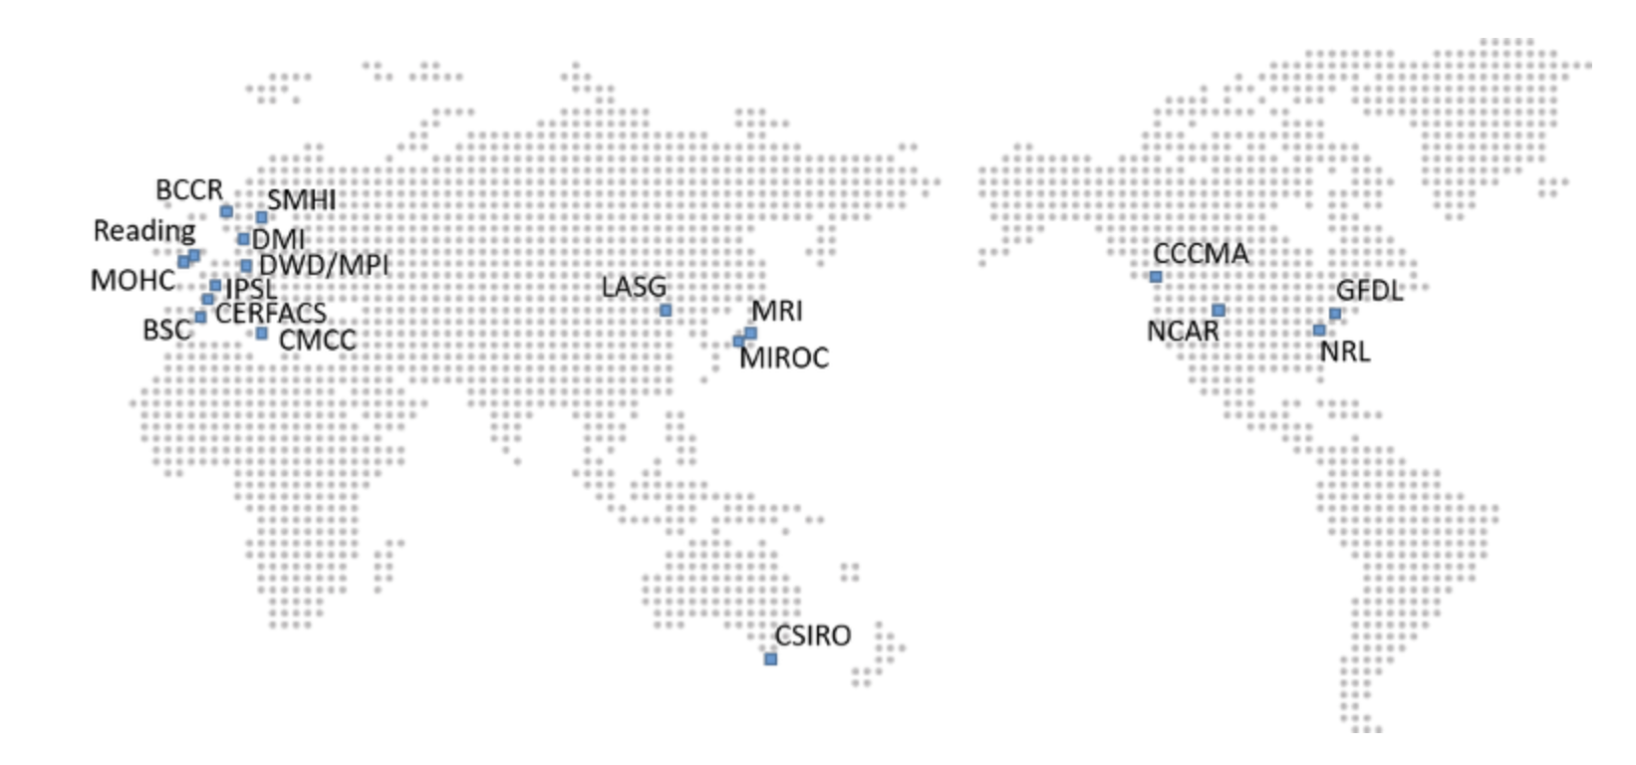
What should we do ?
More reliable projections in near-term? Significantly influenced by internal variability like IPO
Near term climate prediction
https://hadleyserver.metoffice.gov.uk/wmolc/
IAP-DecPreS
IAP Institute of Atmospheric Physics, Chinese Academy of Sciences

Slide 11
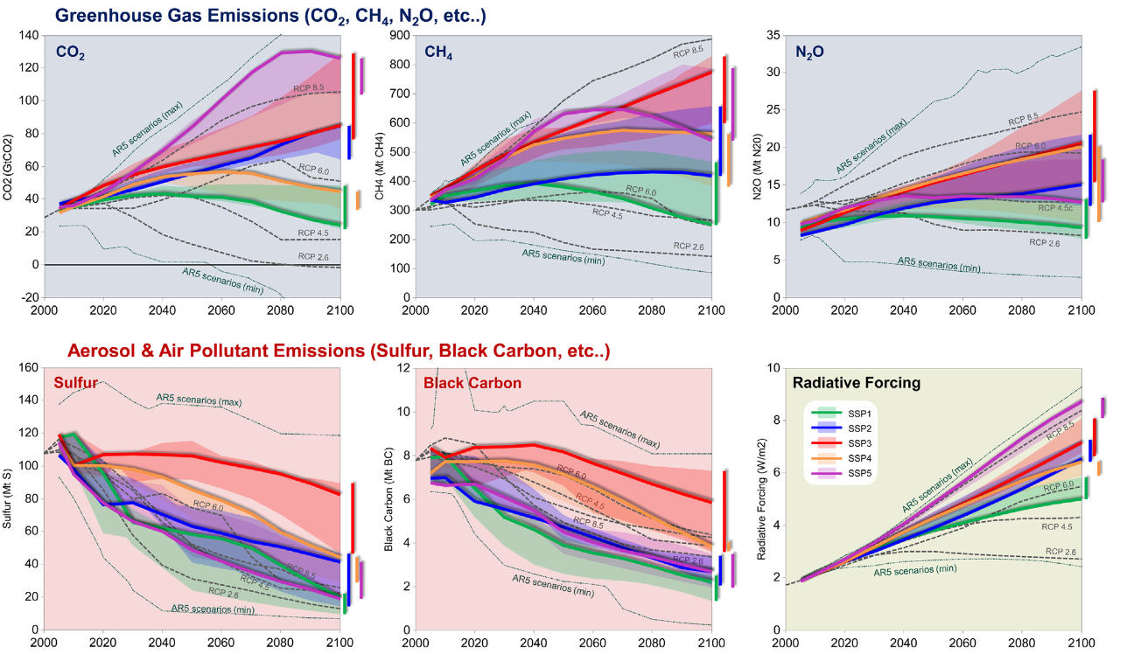
What should we do ?
The relative contribution of increased GHG concentrations and aerosol reductions?
The evolution of GHG and AA emissions under different scenarios
Changes in AOD during 2010-2018
Samset et al., NG 2019)
(Riahi et al., GES 2017)
IAP Institute of Atmospheric Physics, Chinese Academy of Sciences

Slide 12
中国科学院大气物理研究所
Institute of Atmospheric Physics, Chinese Academy of Sciences

