Slide 1
Cold pool, CAPE, and propagation of squall lines:
An analytic analysis
Minghua Zhang
Stony Brook University
Notes:
History of study

Slide 2
Green Honey and Blue Vodka
Prediction of the depth of the honey layer, the propagation speed

Slide 3
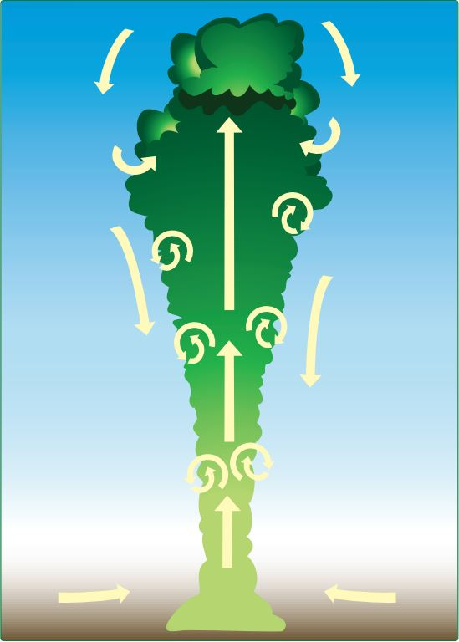
Motivation: the blessed plume model
$$\frac{1}{m_{c}}\frac{∂m_{c}}{∂z}=ε−δ$$
$\frac{∂h_{u}}{∂z}=ε$($h_{e}−h_{u}$)
(The Simpson and Wiggert equation)

Slide 4
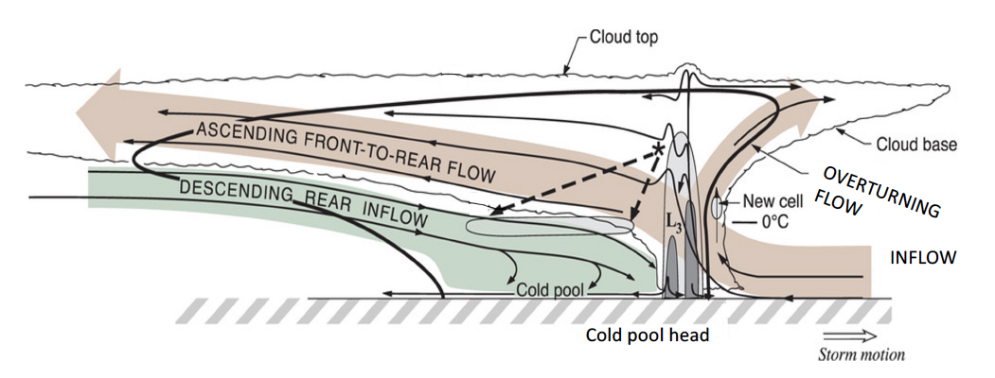
Motivation: organized convection
(From Houze 2018)
The Moncrieff and Green (1972) control equation of the 2-D vorticity:
Buoyancy
Change of the vorticity equals to the forcing by buoyancy.
(From Moncrieff and Green, 1972)

Slide 5
The Moncrieff and Green (1972) form of the 2D vorticity equation
$\frac{Du}{Dt}=−\frac{1}{ρ}\frac{∂p}{∂x}$
$\frac{Dw}{Dt}=−\frac{1}{ρ}\frac{∂p}{∂z}+B$
$\frac{DB}{Dt}=−wN^{2}$
$B=\frac{θ′}{\overline{θ}}g$
$${\left.\left(\frac{η}{ρ}\right)\right|}_{t,z} ={\left.\left(\frac{η}{ρ}\right)\right|}_{t_{0},z_{0}}− \int_{t_{0}}^{t}{\frac{1}{ρ}\frac{∂B}{∂x}dt}$$
$={\left.\left(\frac{η}{ρ}\right)\right|}_{t_{0},z_{0}}+\int_{z_{0}}^{z}{\frac{∂B\left(ψ,z\right)}{∂ψ} dz}$
${\left.\left(\frac{η}{ρ}\right)\right|}_{t,z}={\left.\left(\frac{η}{ρ}\right)\right|}_{t_{0},z_{0}}+\int_{z_{0}}^{z}{\frac{∂B\left(z_{0},z\right)}{∂z_{0}}\frac{1}{ρ_{0}u_{0}} dz }$
$$\frac{D}{Dt}\left(\frac{η}{ρ}\right)=−\frac{1}{ρ}\frac{∂B}{∂x}$$
$$η =\frac{∂u}{∂z}−\frac{∂w}{∂x}=\frac{1}{ρ}\left(\frac{∂^{2}ψ}{∂x^{2}}+\frac{∂^{2}ψ}{∂z^{2}}+\frac{1}{H_{s} } \frac{∂ψ}{∂z}\right)$$
Notes:
Heavy math, history RKW Moncrieff

Slide 6
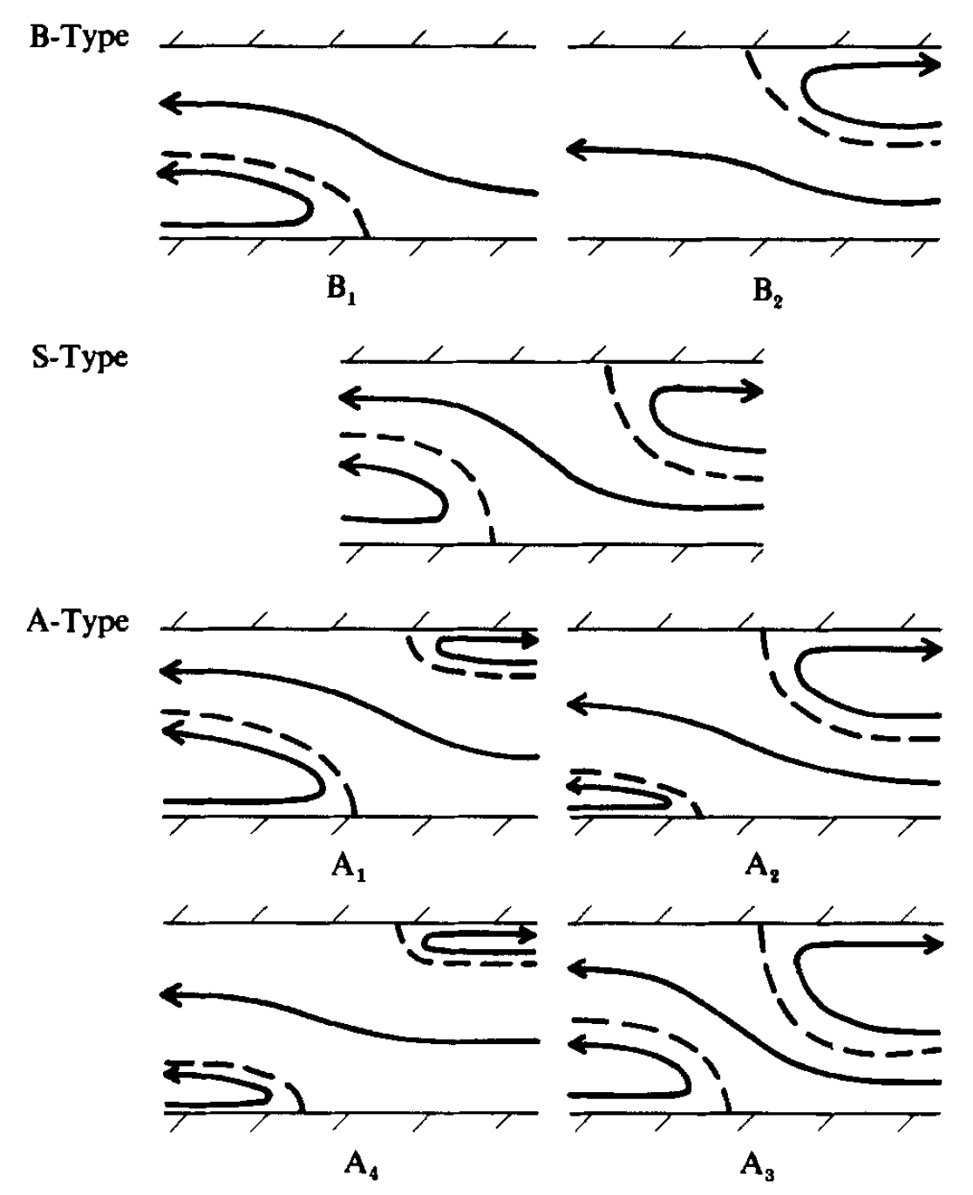
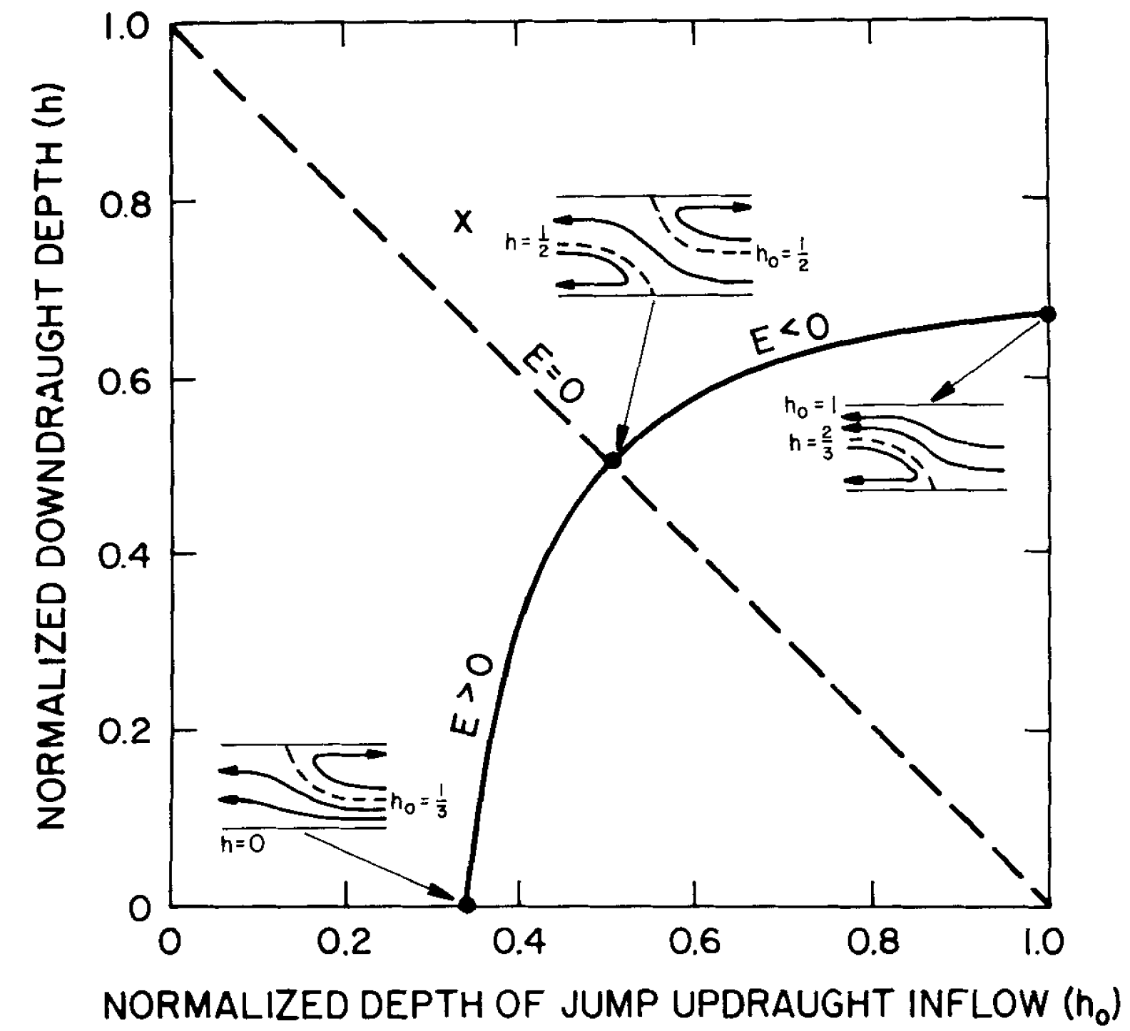
The theory of Moncrieff and collaborators (M&C theory)
(Moncrieff and Green, 1972; Moncrieff and Miller, 1976; Moncrieff, 1978; Moncrieff, 1981; Thorpe et al. 1982; Moncrieff and So,1988; Moncrieff, 1992; Moncrieff, 2004; Moncrieff et al., 2010; Moncrieff et al. 2017)
Schema of the significant types of flow organizations
Figure 6 of Moncrieff and So (1989)
Solutions of the “characteristic-regime equation”
Figure 2 of Moncrieff (1992)

Slide 7
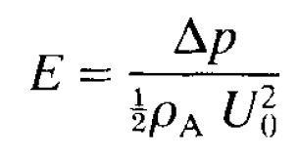
Two key parameters and a characteristic regime equation define the M&C theory
1. The bulk Richardson number (Moncrieff and Green, 1972)
$$\frac{∂^{2}ψ}{∂x^{2} }+\frac{∂^{2}ψ}{∂z^{2} }+\frac{1}{H_{s} } \frac{∂ψ}{∂z}=\frac{ρ^{2}}{ρ_{0}}η_{0}+\frac{ρ^{2}}{ρ_{0}u_{0}}\int_{z_{0}}^{z}{\frac{∂B\left(z_{0},z\right)}{∂z_{0}} dz}$$
R is a measure of the ratio of the available potential energy to the kinetic energy change.
∆U is the difference of mean wind between the top and bottom of the model
2. The Bernoulli number (Moncreiff and So, 1989)
$${\left.\left(\frac{V^{2}}{2}+\frac{p}{ρ}\right)\right|}_{t,z} ={\left.\left(\frac{V^{2}}{2}+\frac{p}{ρ}\right)\right|}_{t_{0},z_{0}}+ \int_{z_{0}}^{z}{B\left(z_{0},z\right)dz }$$
$∆p$ is the pressure perturbation at the top of the downdraught inflow $h$; $U_{0}$ is the relative inflow to the jump updraught.
3. The “characteristic regime equation” that relates $h$ with $h_{0}$, the depths of the inflow and the downdraft

Slide 8
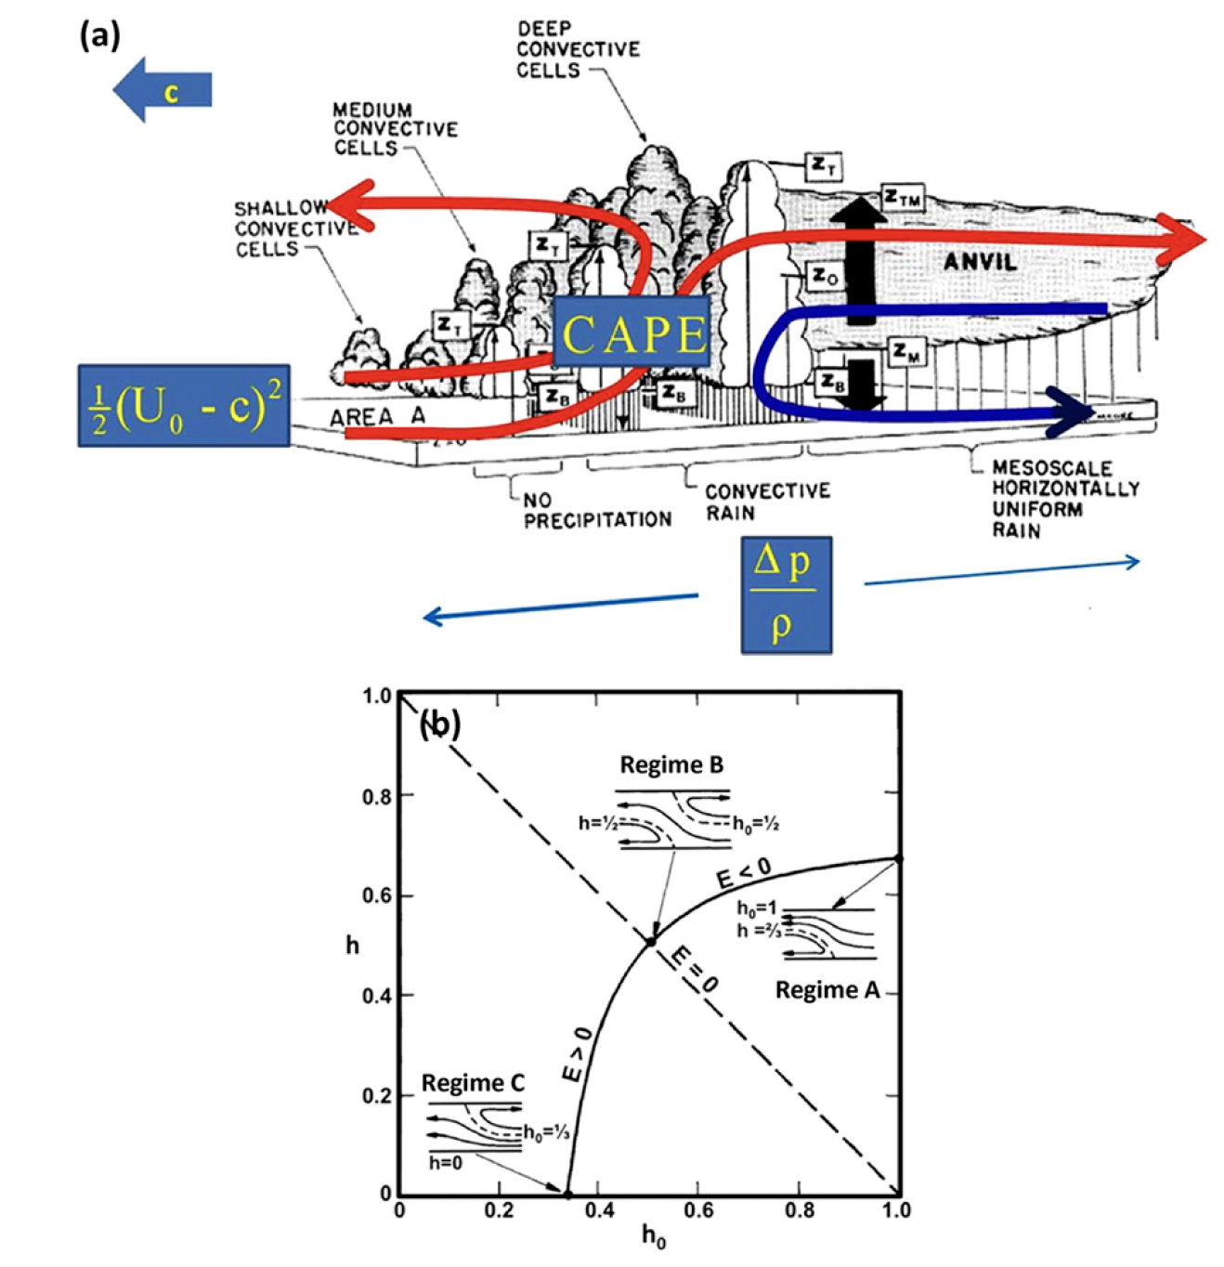
The Richardson number:
$$R =\frac{CAPE}{\frac{1}{2}{\left(U_{0}−c\right)}^{2}}$$
The Bernoulli number:
$$E =\frac{∆p}{\frac{1}{2}{ρ\left(U_{0}−c\right)}^{2}}$$
The characteristic regime equation:
$$F\left(h_{0},h,E\right)=0$$
Figure 11 of Moncrieff et al. (2017)

Slide 9
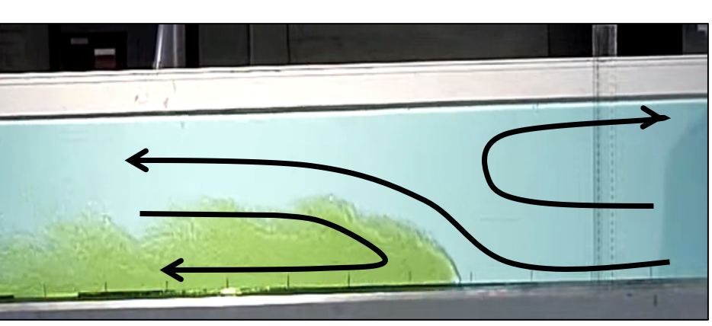
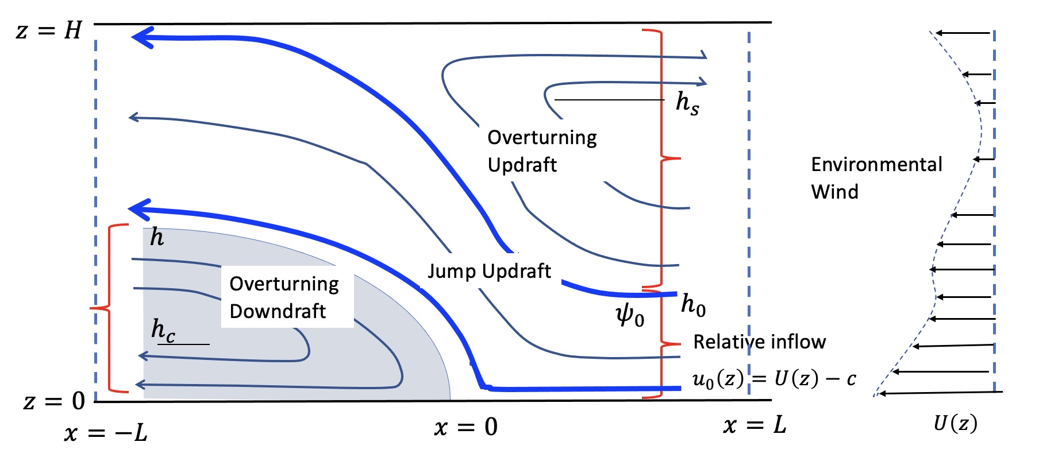
The model
The equations of the three flows
$$\frac{∂^{2}ψ}{∂x^{2} }+\frac{∂^{2}ψ}{∂z^{2} }+\frac{1}{H_{s} } \frac{∂ψ}{∂z}=\frac{ρ^{2}}{ρ_{0}}η_{0}+\frac{ρ^{2}}{ρ_{0}u_{0}}\int_{z_{0}}^{z}{\frac{∂B\left(z_{0},z\right)}{∂z_{0}} dz}$$
$$\frac{∂^{2}ψ}{∂x^{2} }+\frac{∂^{2}ψ}{∂z^{2} }+\frac{1}{H_{s} } \frac{∂ψ}{∂z}=F\left(ψ, z\right)$$
Constraint on the propagation speed:
$${ u}_{h}^{2} = u_{c0}^{2} −2\int_{0}^{h}{B_{c}\left(z\right)dz+2×CAPE\left(0,h\right)}$$
$${ u}_{h}^{}$$
Constraint on the depth of the overturning updraft:
$$u_{c0}$$
$\int_{h_{0}}^{h_{s}}{ρu_{0}\left(z_{0}\right)dz_{0}+}\int_{h_{s}}^{H}{ρudz=}0$
Constraint on the depth of the downdraft by using the total momentum budget (“the characteristic regime equation” in the M&C theory):
(Zhang 2022, under review at AGU Advances)

Slide 10
Summary
Squall lines are organized nonlinear dynamical systems with small degrees of freedom under given environmental condition.
The formulated model leads to prediction of squall line properties if CAPE and environmental wind are known: propagation speed, depth of the cold pool, depths of the jump updraft and overturning updraft, and mass fluxes of these flows.
Potential applications:
Infer squall line properties by using environmental conditions or some observed property.
A model for parameterization of organized convection in coarse resolution models
Interpretation of squall line simulations from high-resolution models
The model is yet to be numerically implemented and validated.
(Zhang 2022, under review at AGU Advances)

